Slide 1
Hong Kong-Shenzhen Metro Route Planning System
in Greater Bay Area
CS3343 Software Engineering Practice
Project Group 6

Slide 2
背景
Background

Slide 3
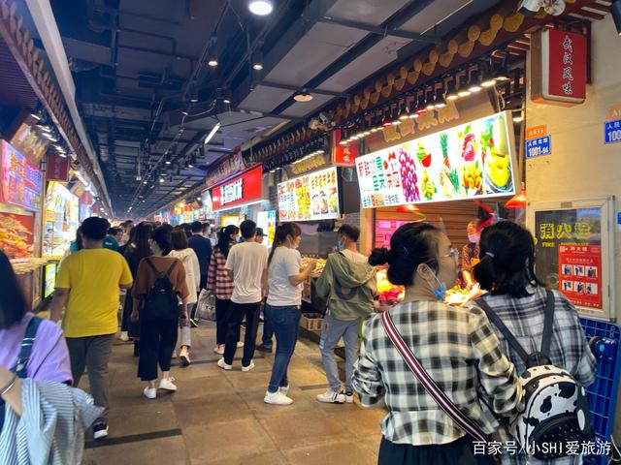
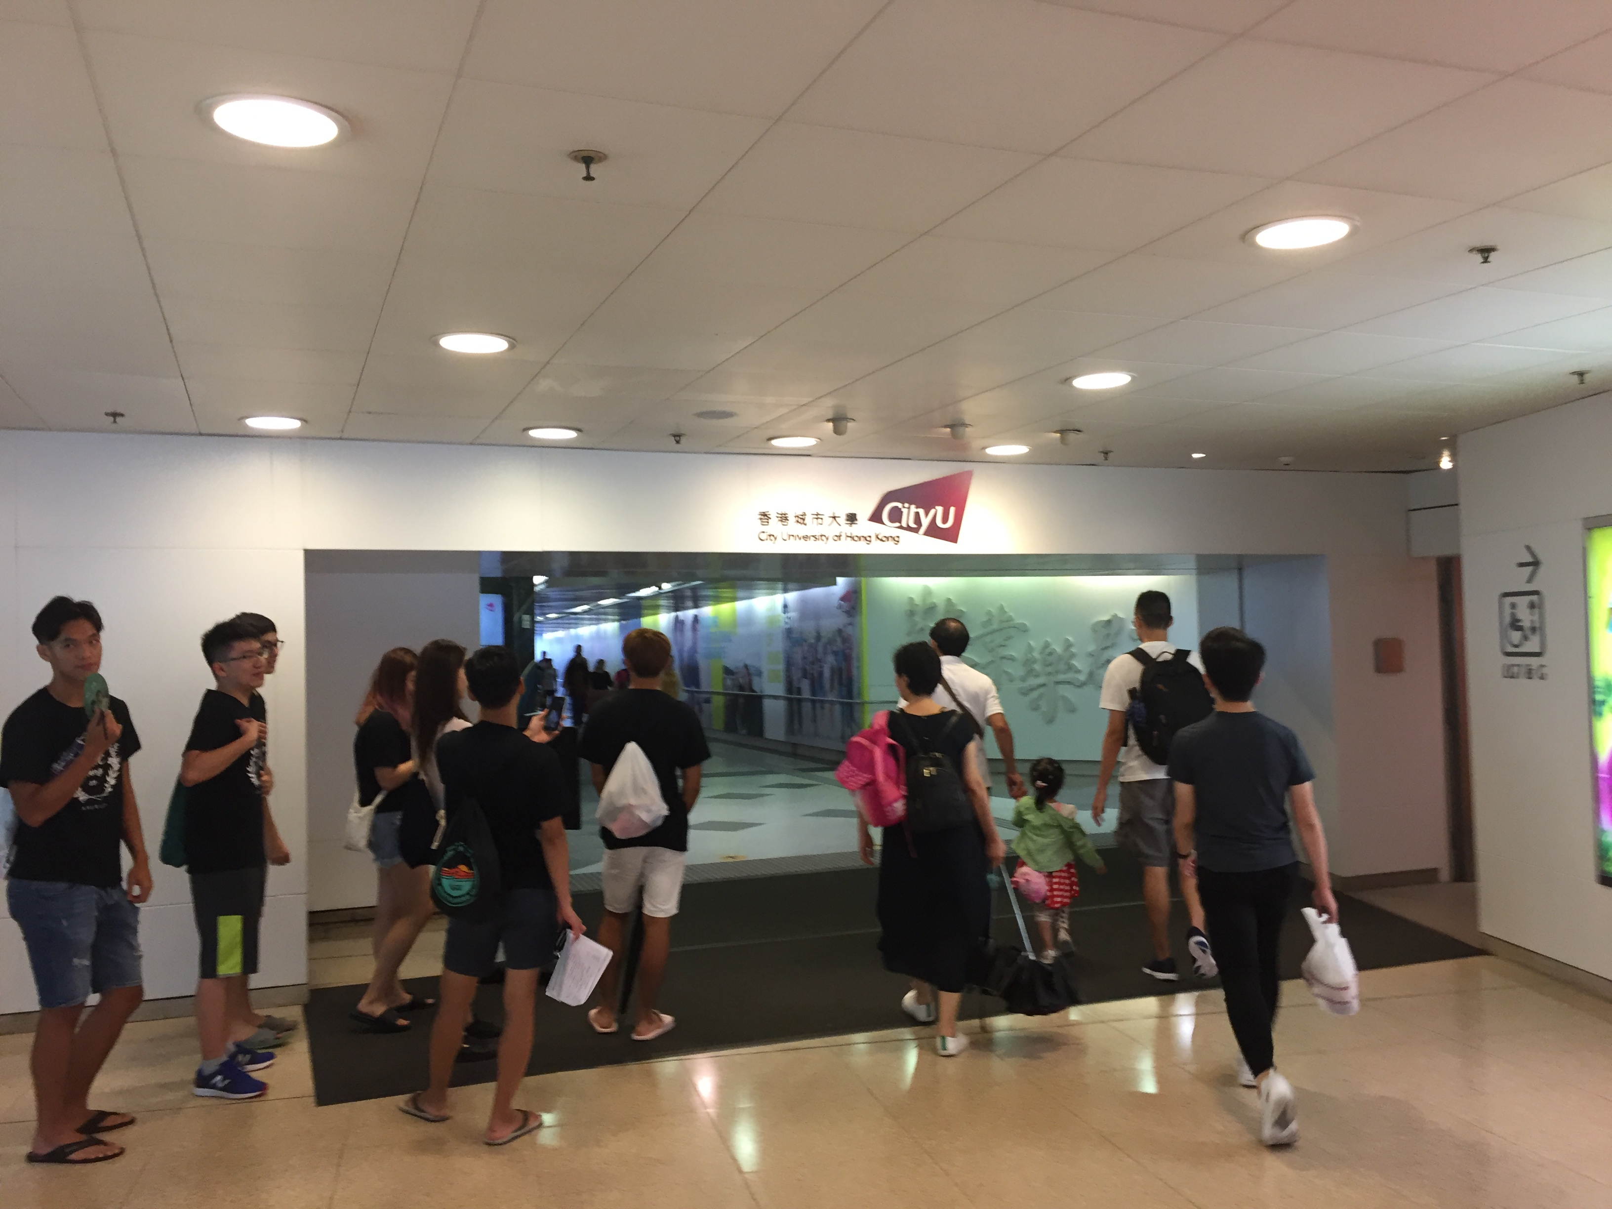
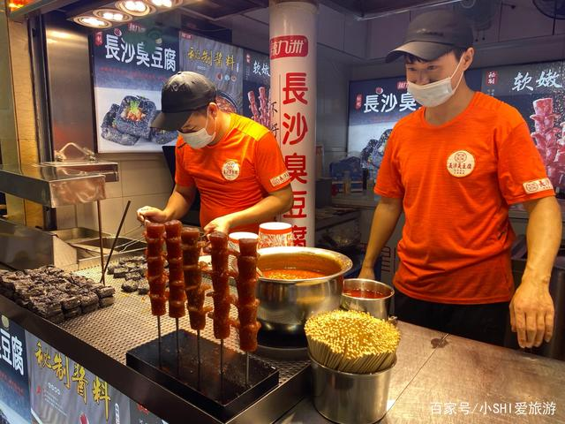


Background
At Past…
Ahh,
want to go to Shenzhen
to eat stinky tofu and insect feast

Slide 4
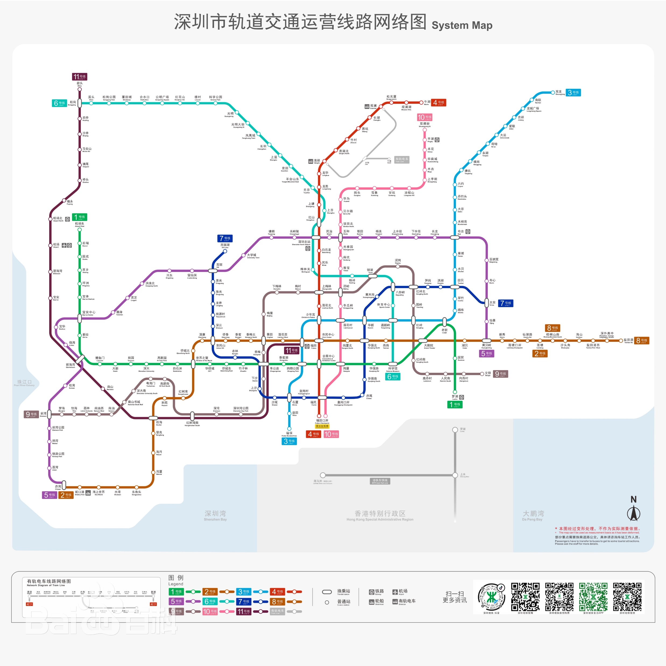
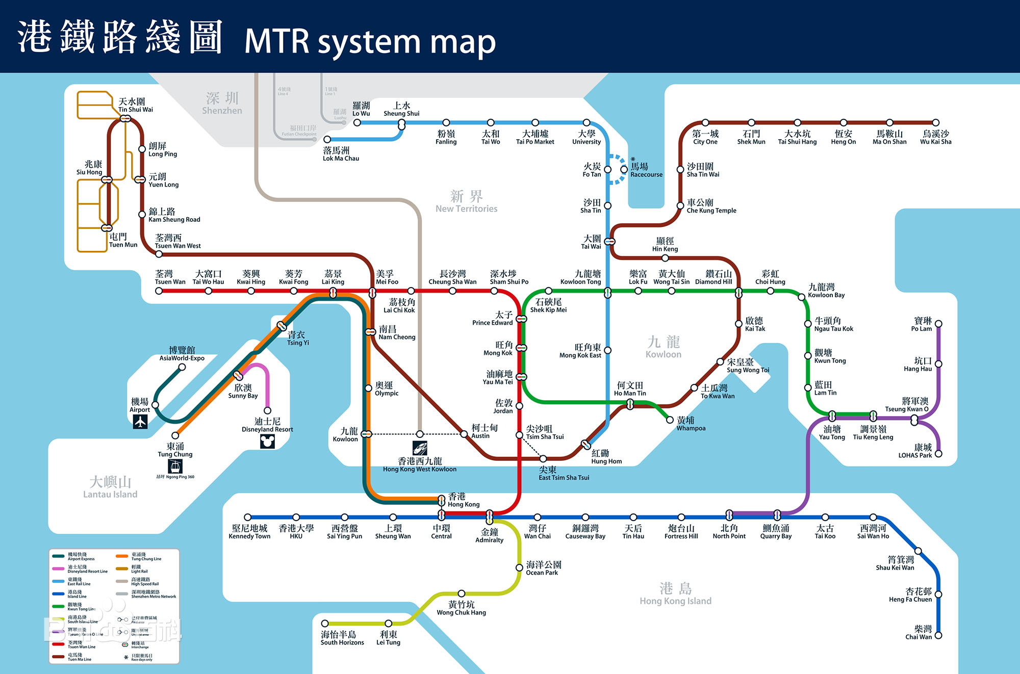


Background
At Past…
So many ways,
Which one
Should I select?

Slide 5
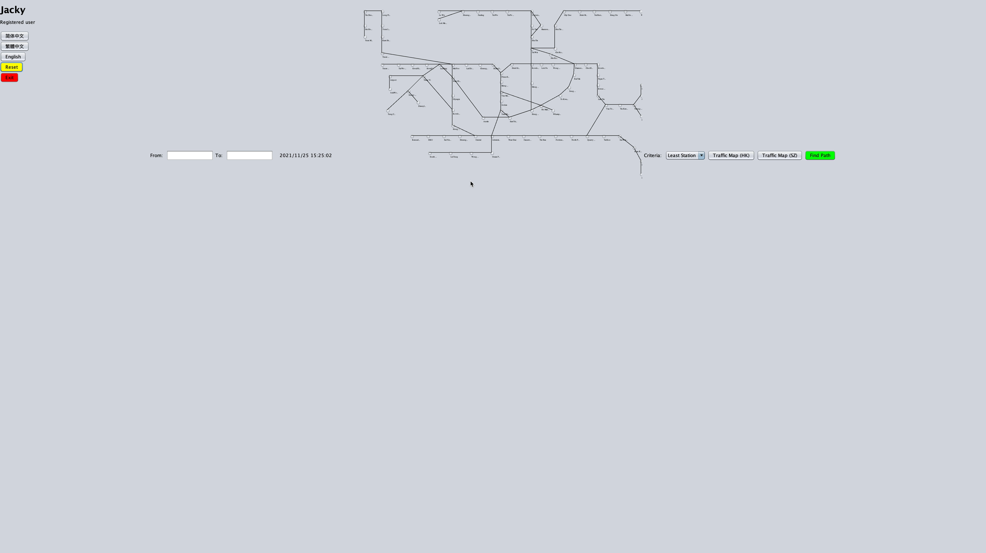
Background
Now, with our program,
from Hong Kong to Shenzhen AUTO PLANNING!
Demo

Slide 6









Background
Objective
Easier to go to the workplace!
More convenient to go on a trip!
DEVELOP!!!
A good platform for administration.

Slide 7

Outline
Background
Management
Design
Development
Verification
User Interface

Slide 8
管理
Management

Slide 9
Management
Methodology
Waterfall Development Model
Requirements
Design
Implementation
Verification
Maintenance
Information
Structure
Function
Testing
Use

Slide 10

Management
Members
Algorithm Group
UI Group
Member | Position
HUANG Yuqin | Program Developer, Program Tester
LIU Wei | Program Developer, Program Tester
WANG Zhixuan | Assistant Program Manager
XU Jiakai | Program Designer, Program Developer
XU Rui | Program Manager
ZHANG Xun | Program Developer, Interface Designer
HUANG Yuqin
LIU Wei
WANG Zhixuan
XU Jiakai
XU Rui
ZHANG Xun
Data Integration & I/O Module
UI Design & Programming
UI Data Processing & Drawing
Algorithm Design Principle & Pattern
Algorithm Core & Testing
UI Data Processing & Drawing

Slide 11
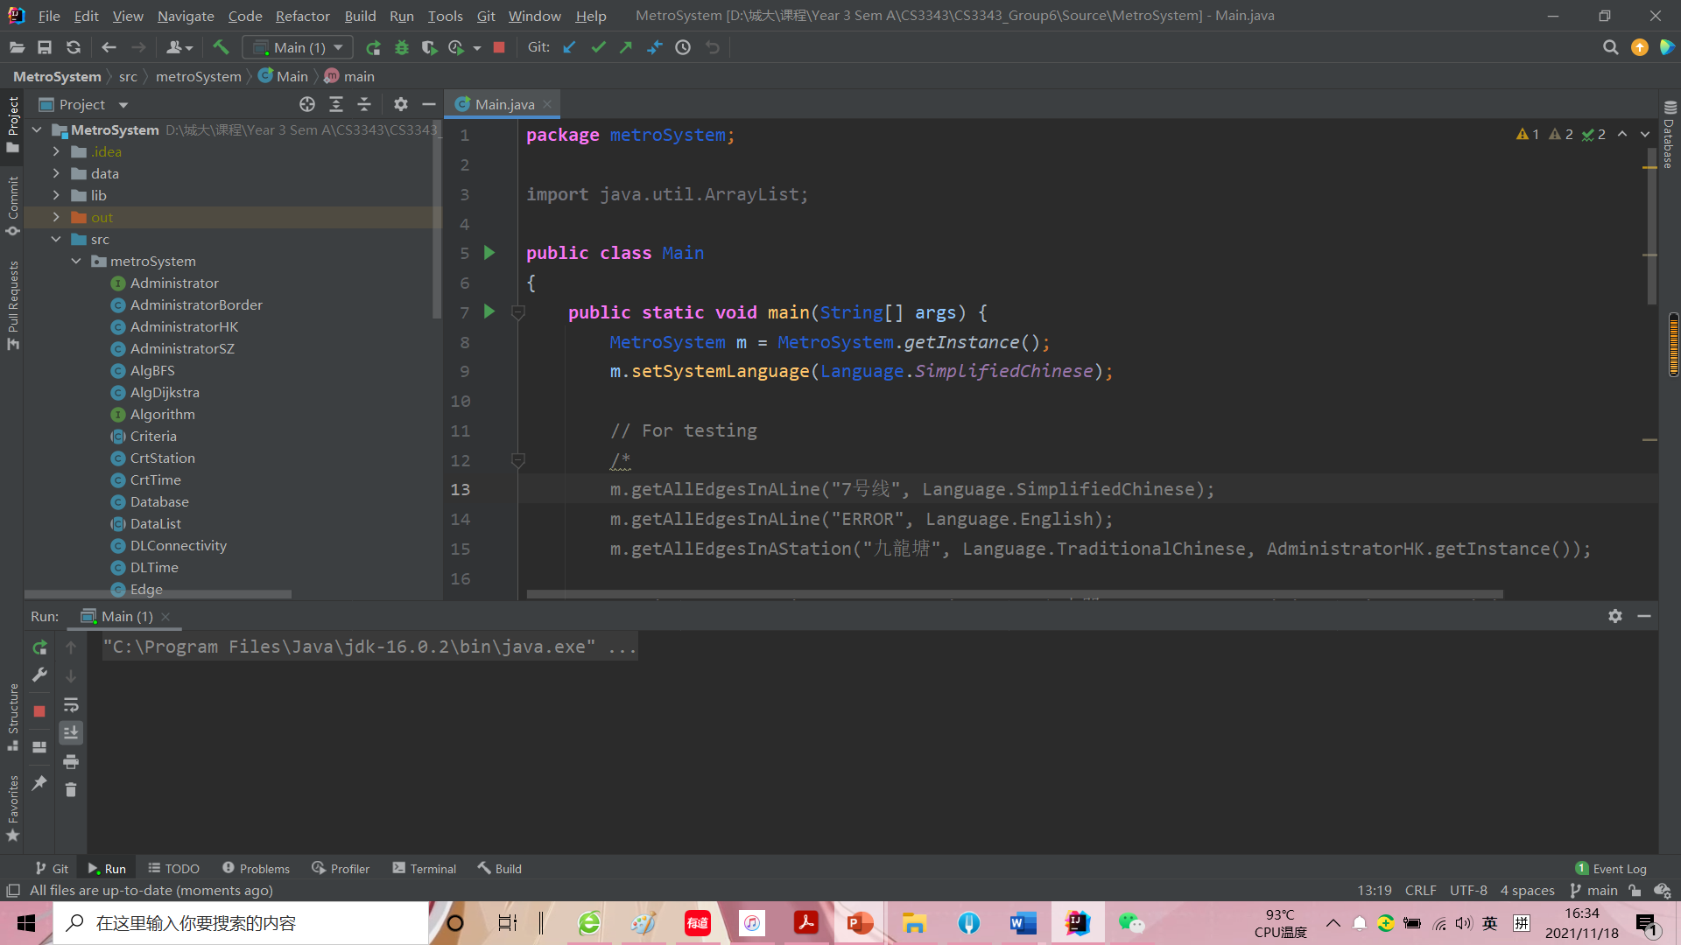
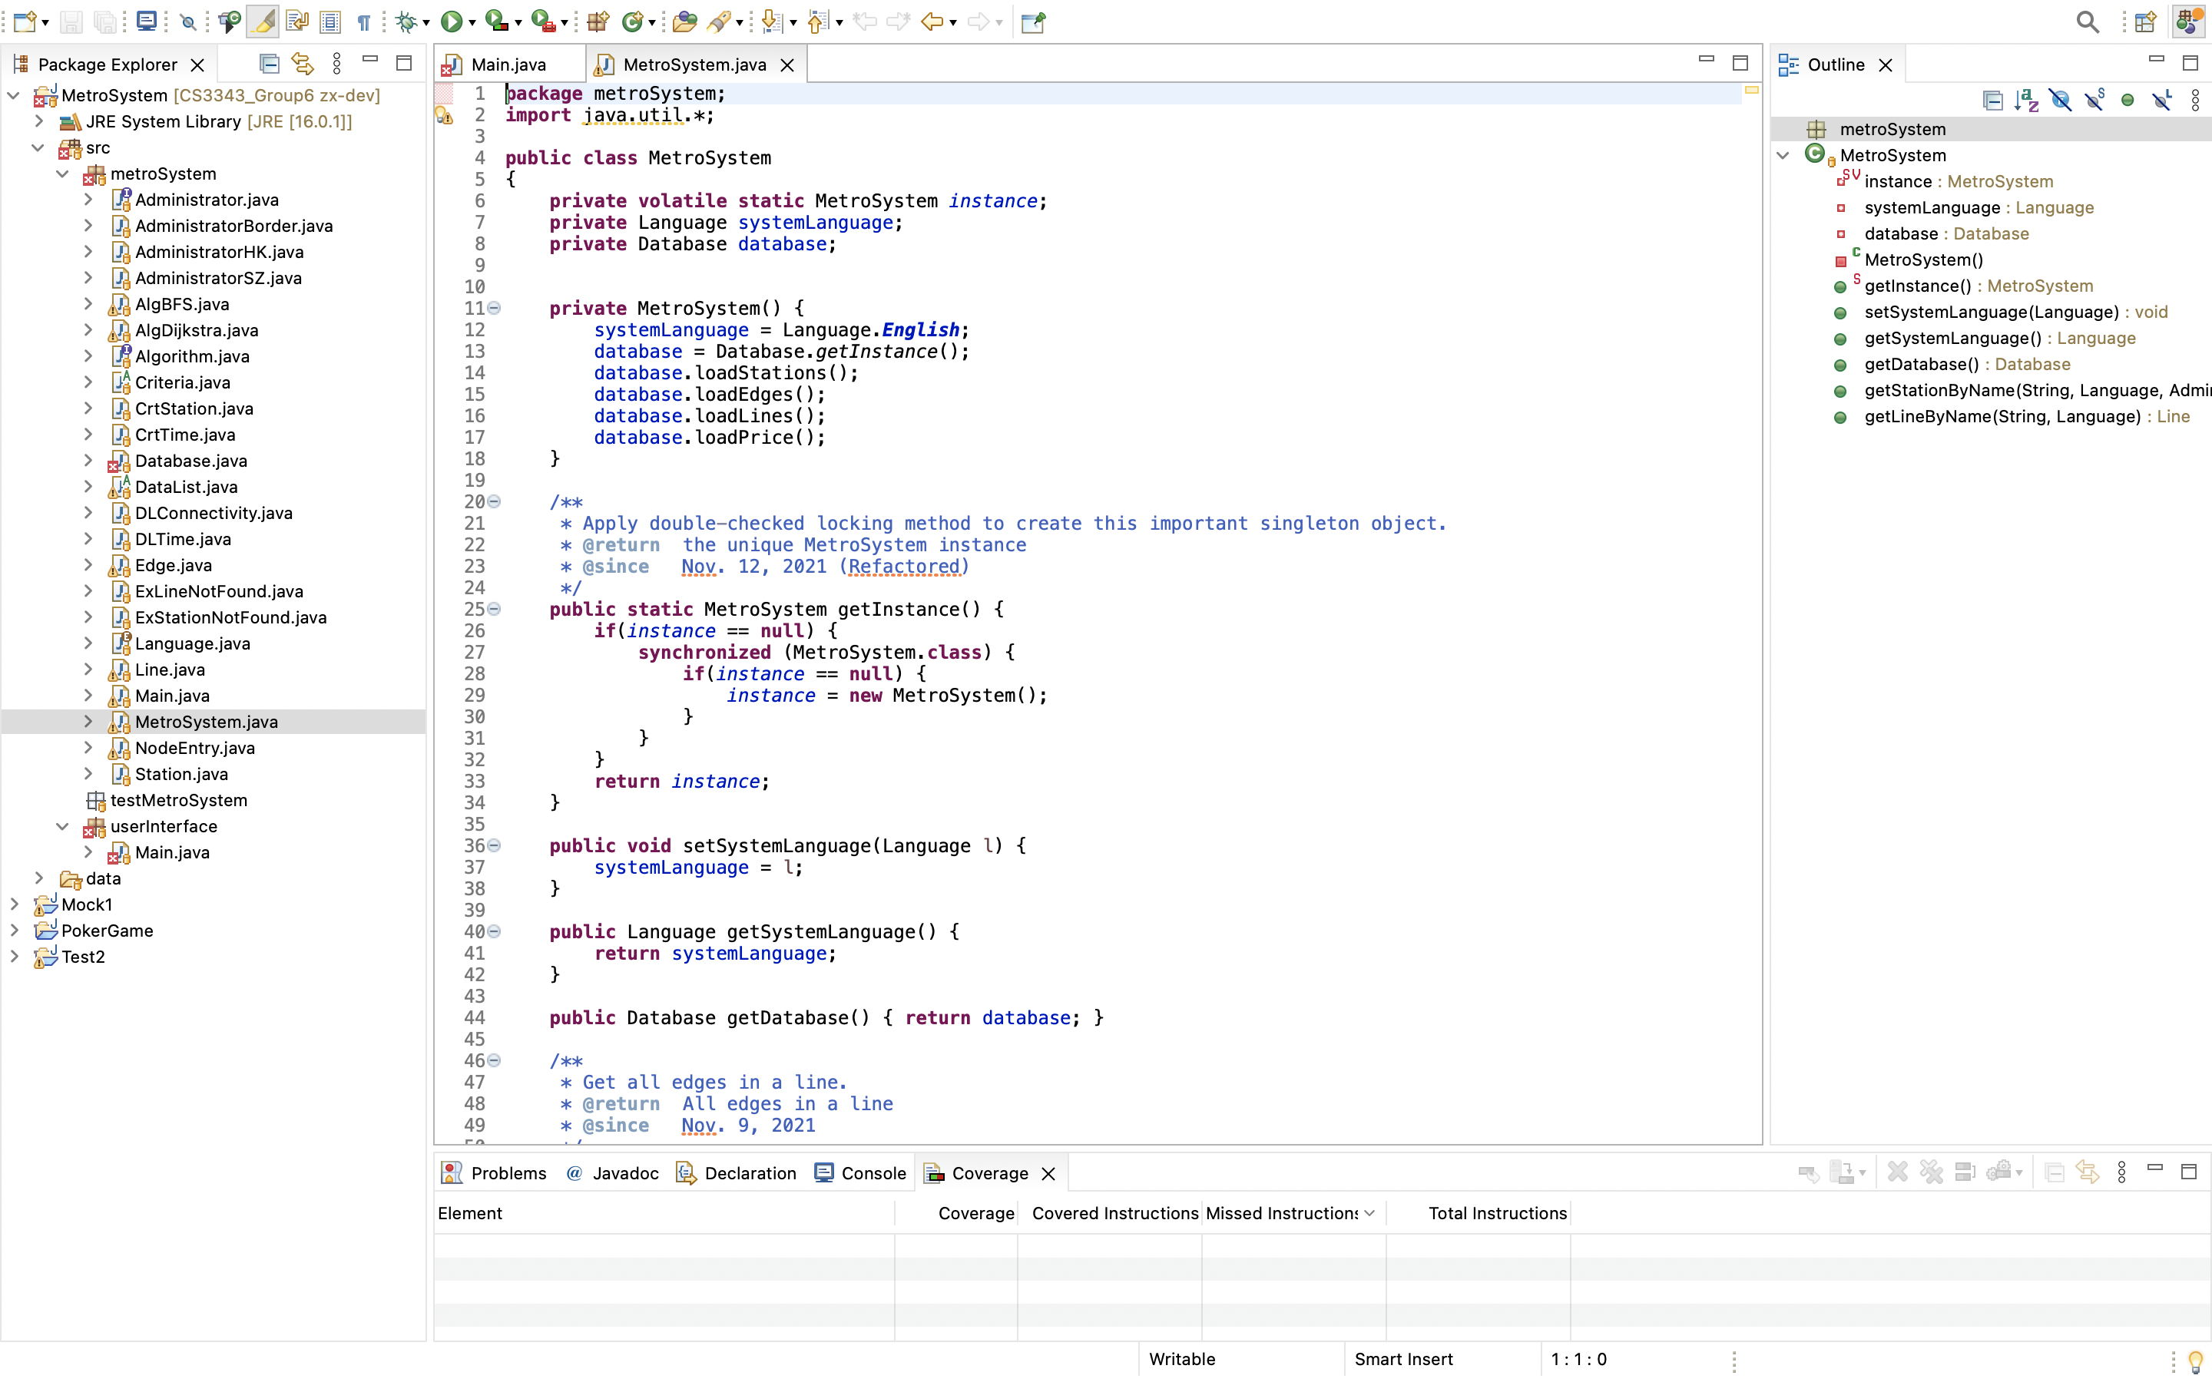
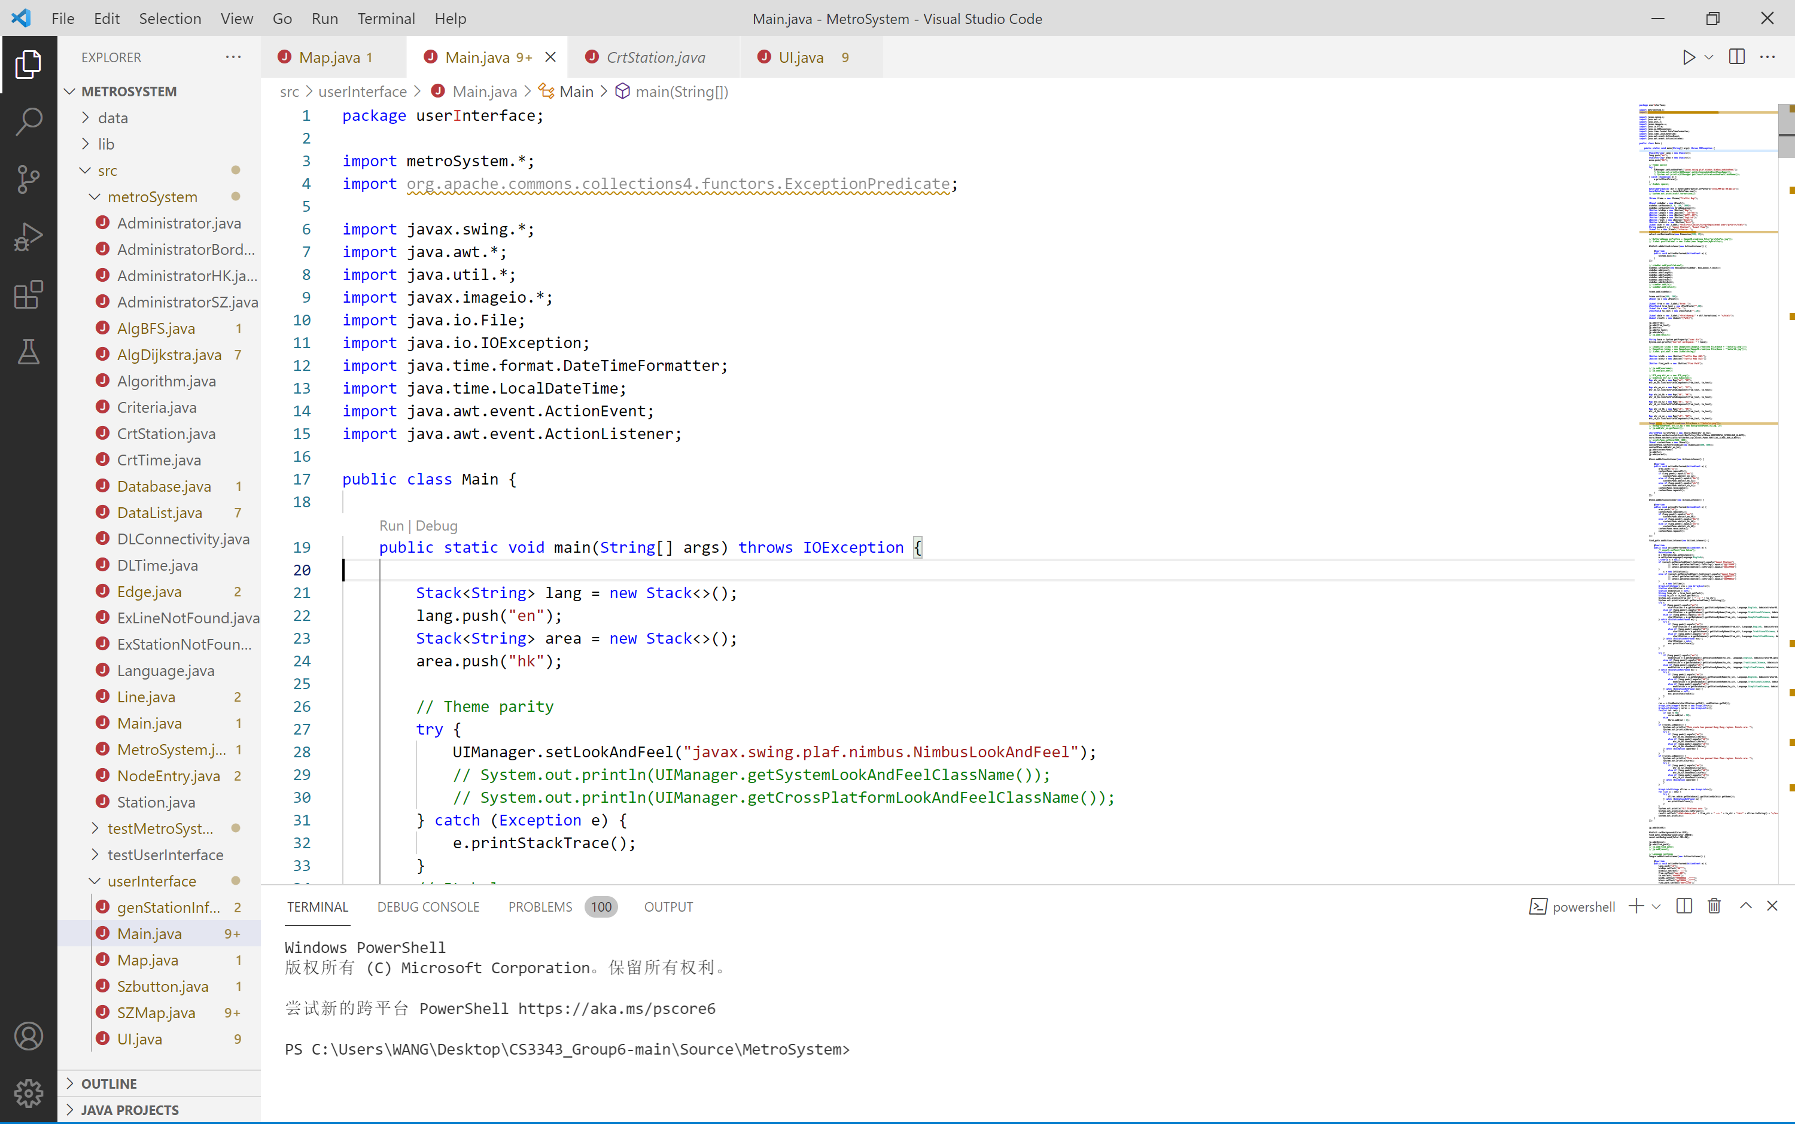

Management
Tools
Development IDE
IntelliJ IDEA
Eclipse
VS Code
External Library

Slide 12
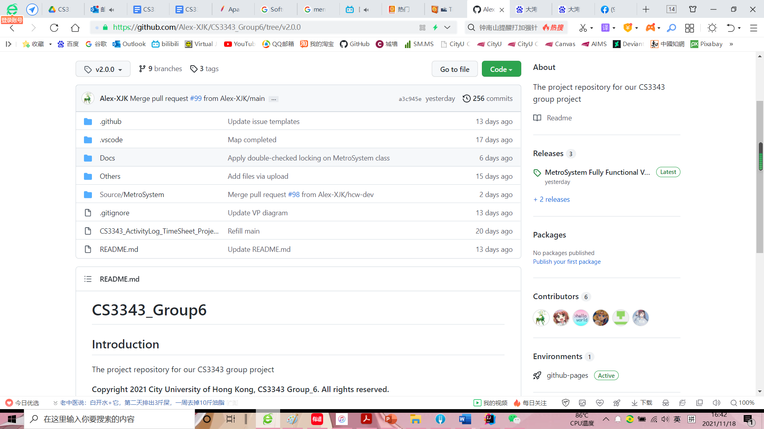
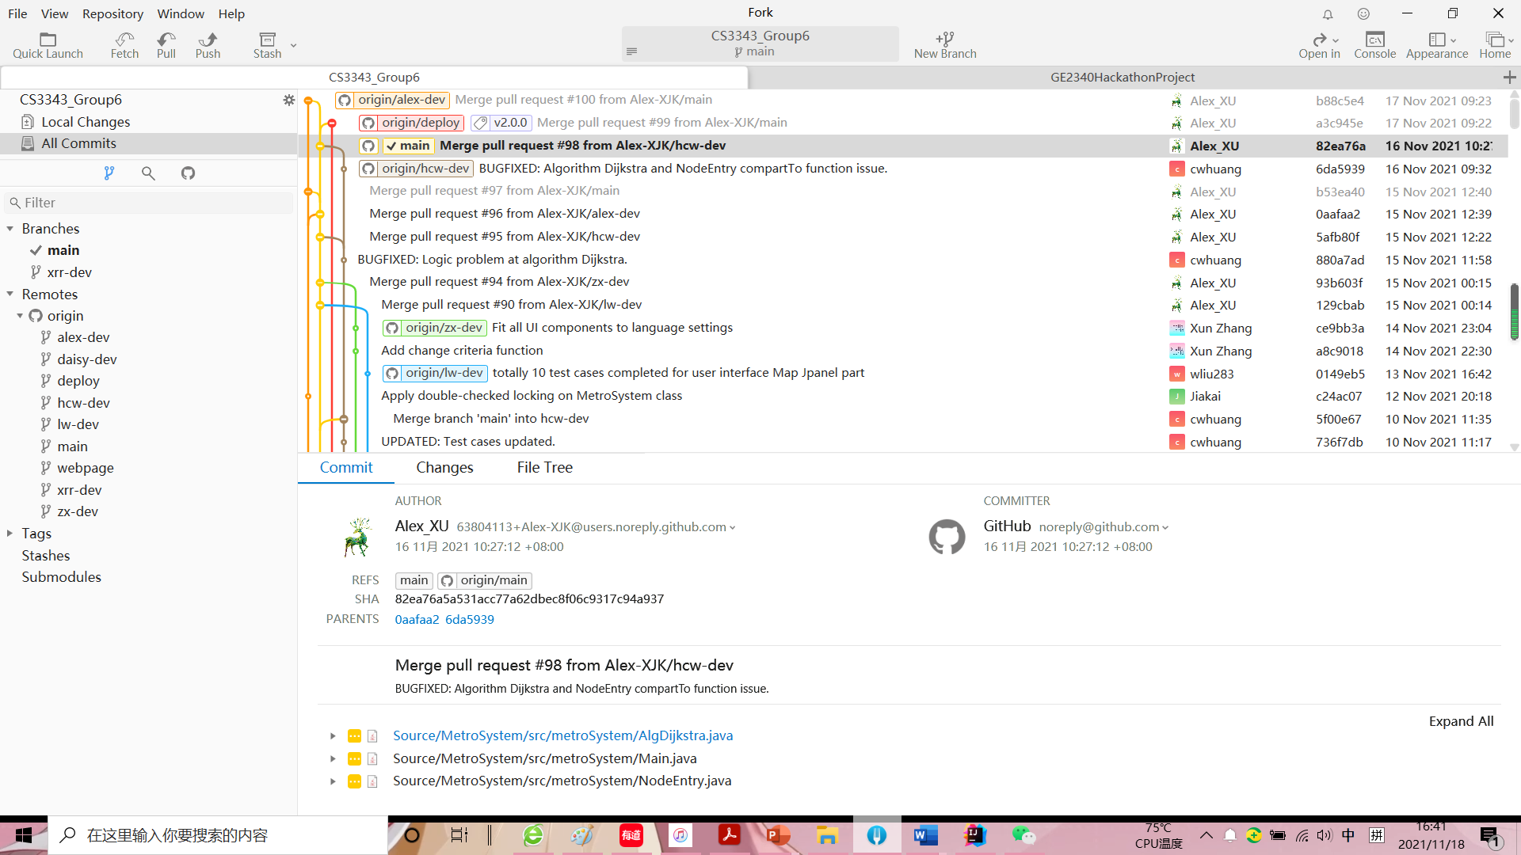
Management
Configuration
Version Control
GitHub
Fork

Slide 13
Management
Work
0.0
Hong Kong-Shenzhen Metro Route Planning System
Process-type, Top-down
1.0
2.0
3.0
4.0
5.0
6.0
7.0
Project Management
Requirements Gathering
Analysis and Design
Software Development
Testing
Debugging and Refactoring
Documentation
1.1
1.2
2.1
2.2
3.1
3.2
3.3
5.1
5.2
5.3
Position Assignment
Work Assignment
Information Searching
Information Integration
Requirement Analysis
Algorithm Selection
Project Structure Outline
Unit Testing
Integration Testing
System Testing

Slide 14
Management
Work
0.0
Hong Kong-Shenzhen Metro Route Planning System
Process-type, Top-down
1.0
2.0
3.0
4.0
5.0
6.0
7.0
Project Management
Requirements Gathering
Analysis and Design
Software Development
Testing
Debugging and Refactoring
Documentation
4.1
4.2
4.3
4.4
Overall Structure Development
File I/O Development
Algorithm Development
UI Development
4.1.1
4.1.2
4.2.1
4.2.2
4.2.3
4.3.1
4.3.2
4.3.3
4.4.1
4.4.2
4.4.3
System Structure Development
Interface Reservation
Data Formatting
I/O Module Development
Interface to Overall Structure
Algorithm Programming
Algorithm Module Development
Interface to Overall Structure
UI Development Method Searching
UI Programming/Drawing
Interface to Overall Structure

Slide 15
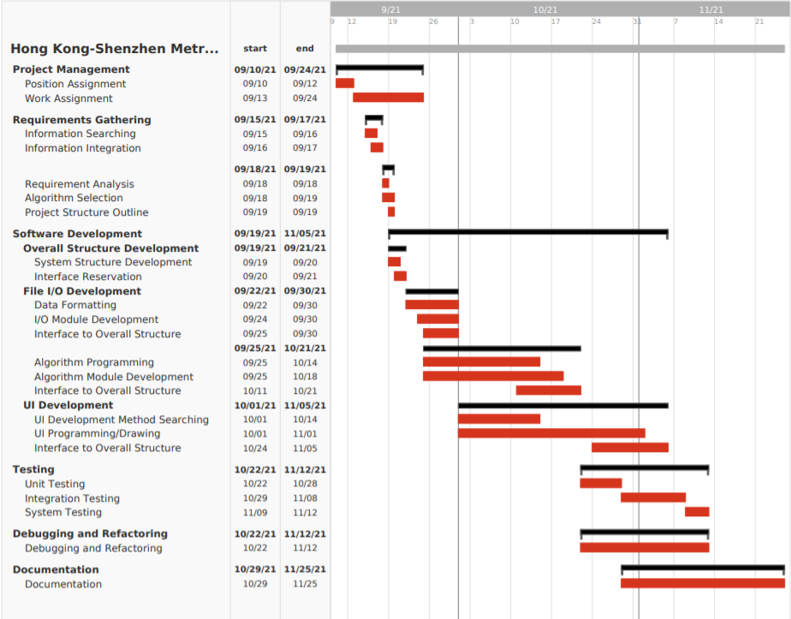
Management
Schedule

Slide 16
設計
Design

Slide 17
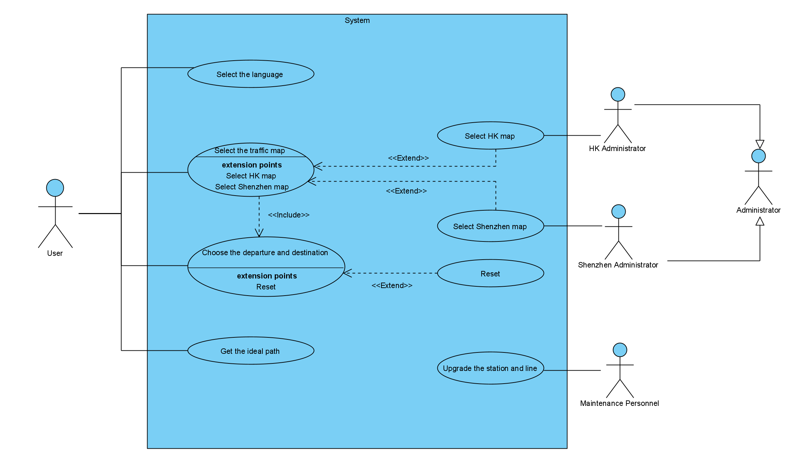
Design
Use Case

Slide 18
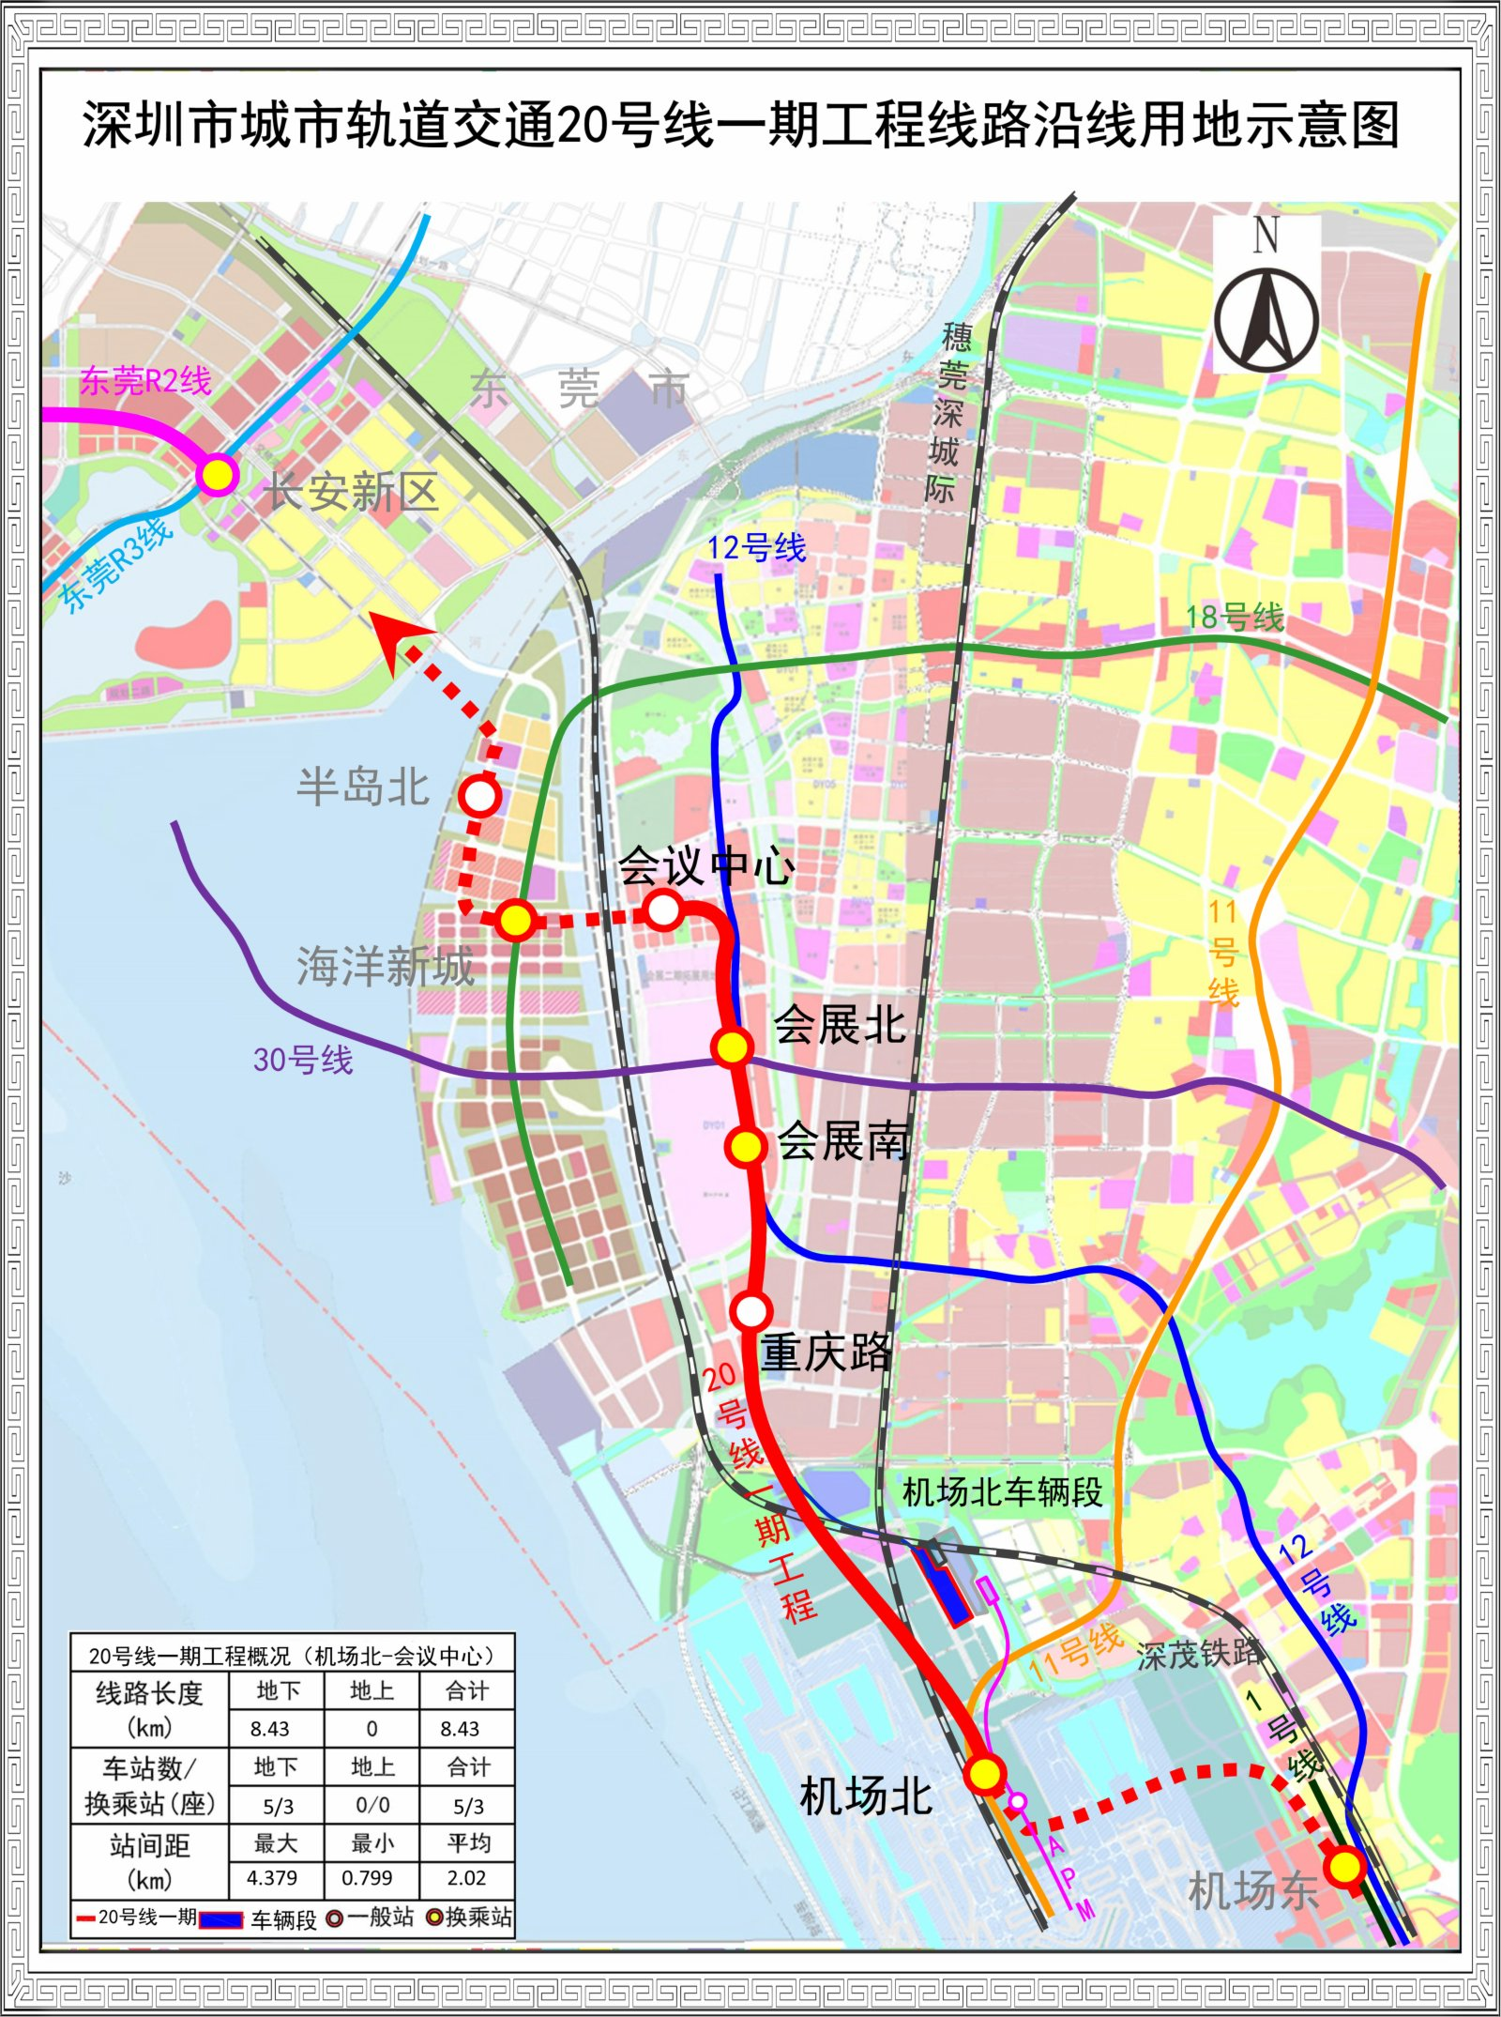
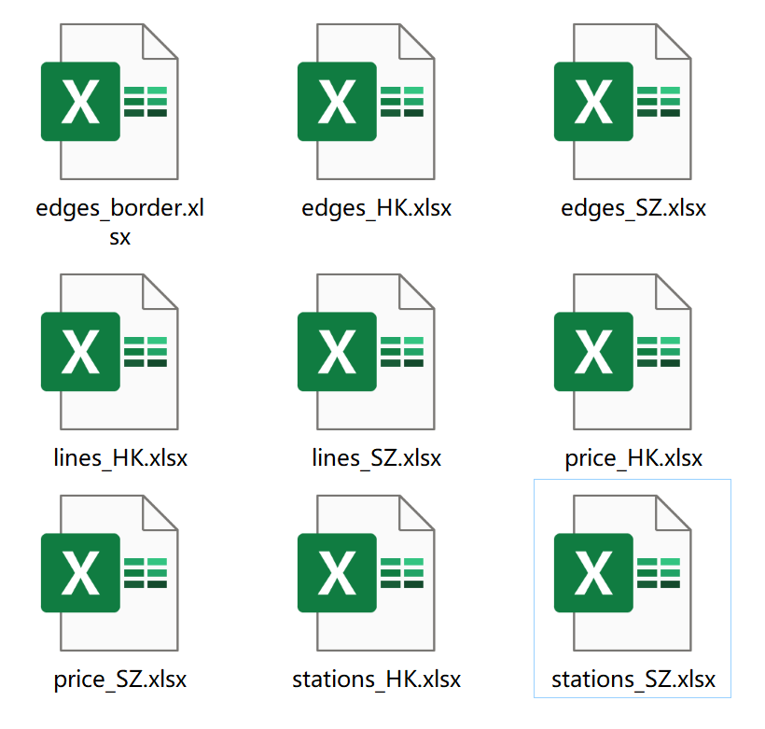
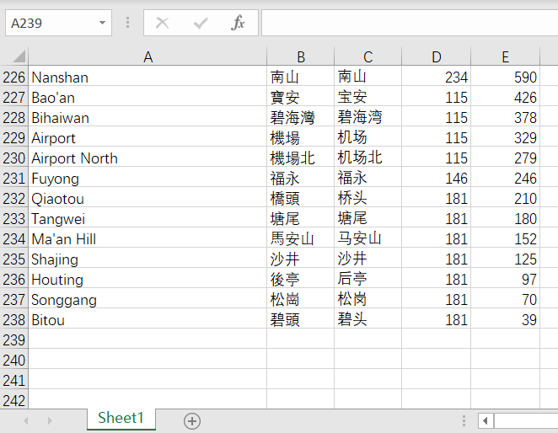
Design
Upgrade Method
Here to append

Slide 19
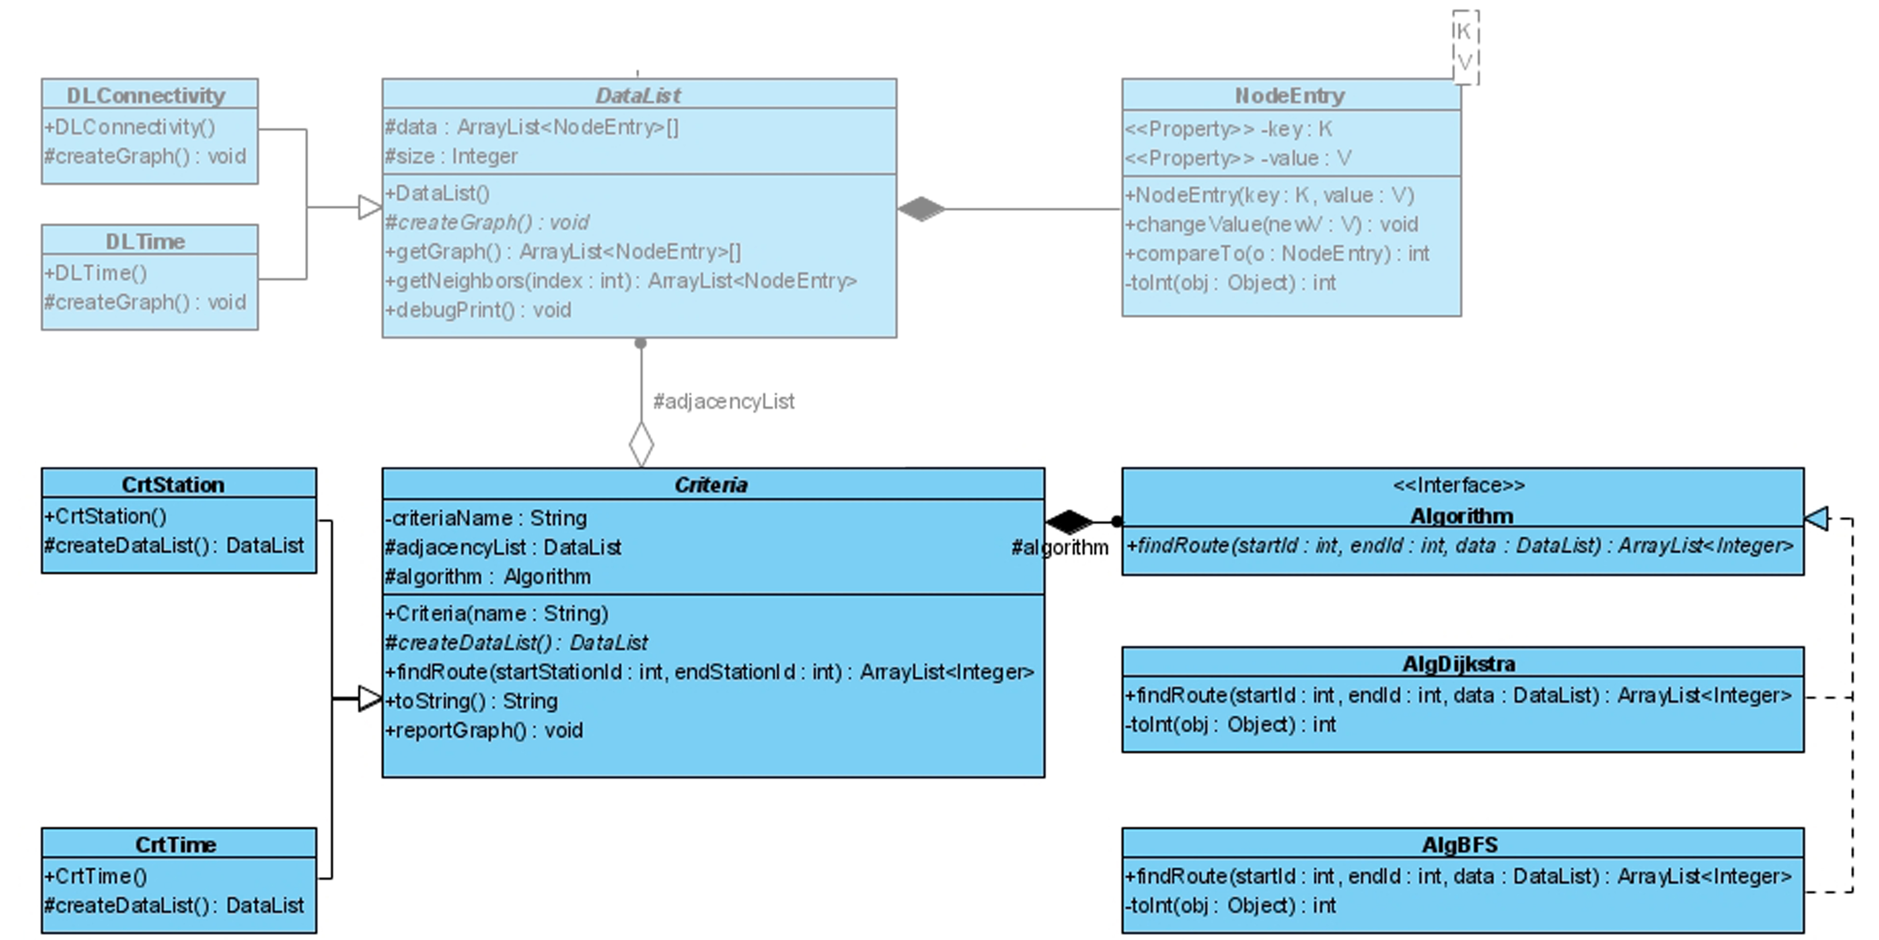
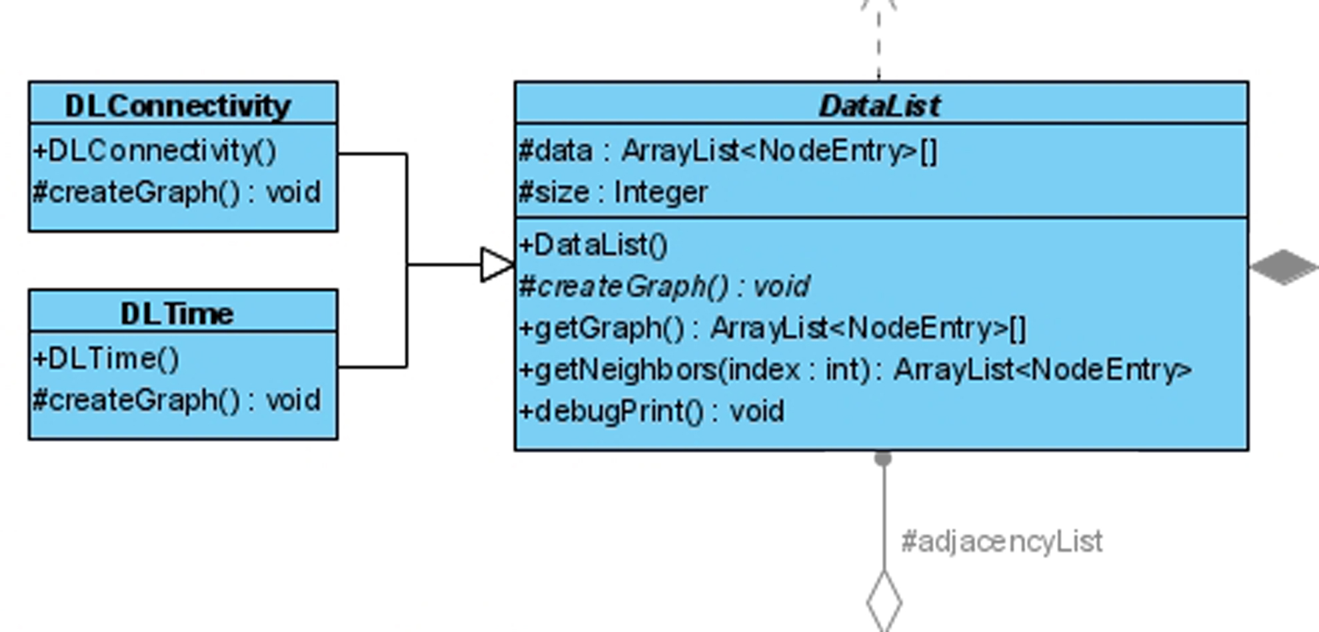
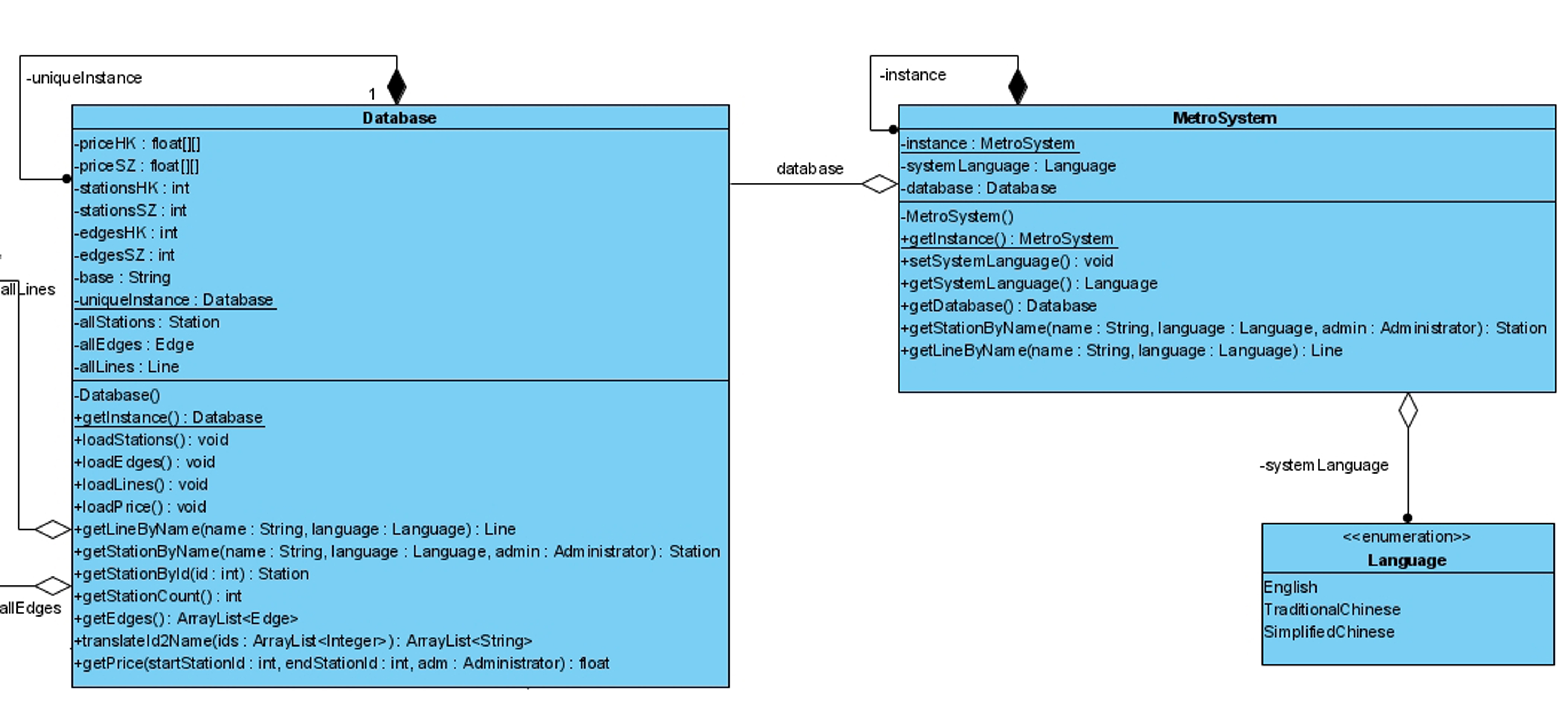
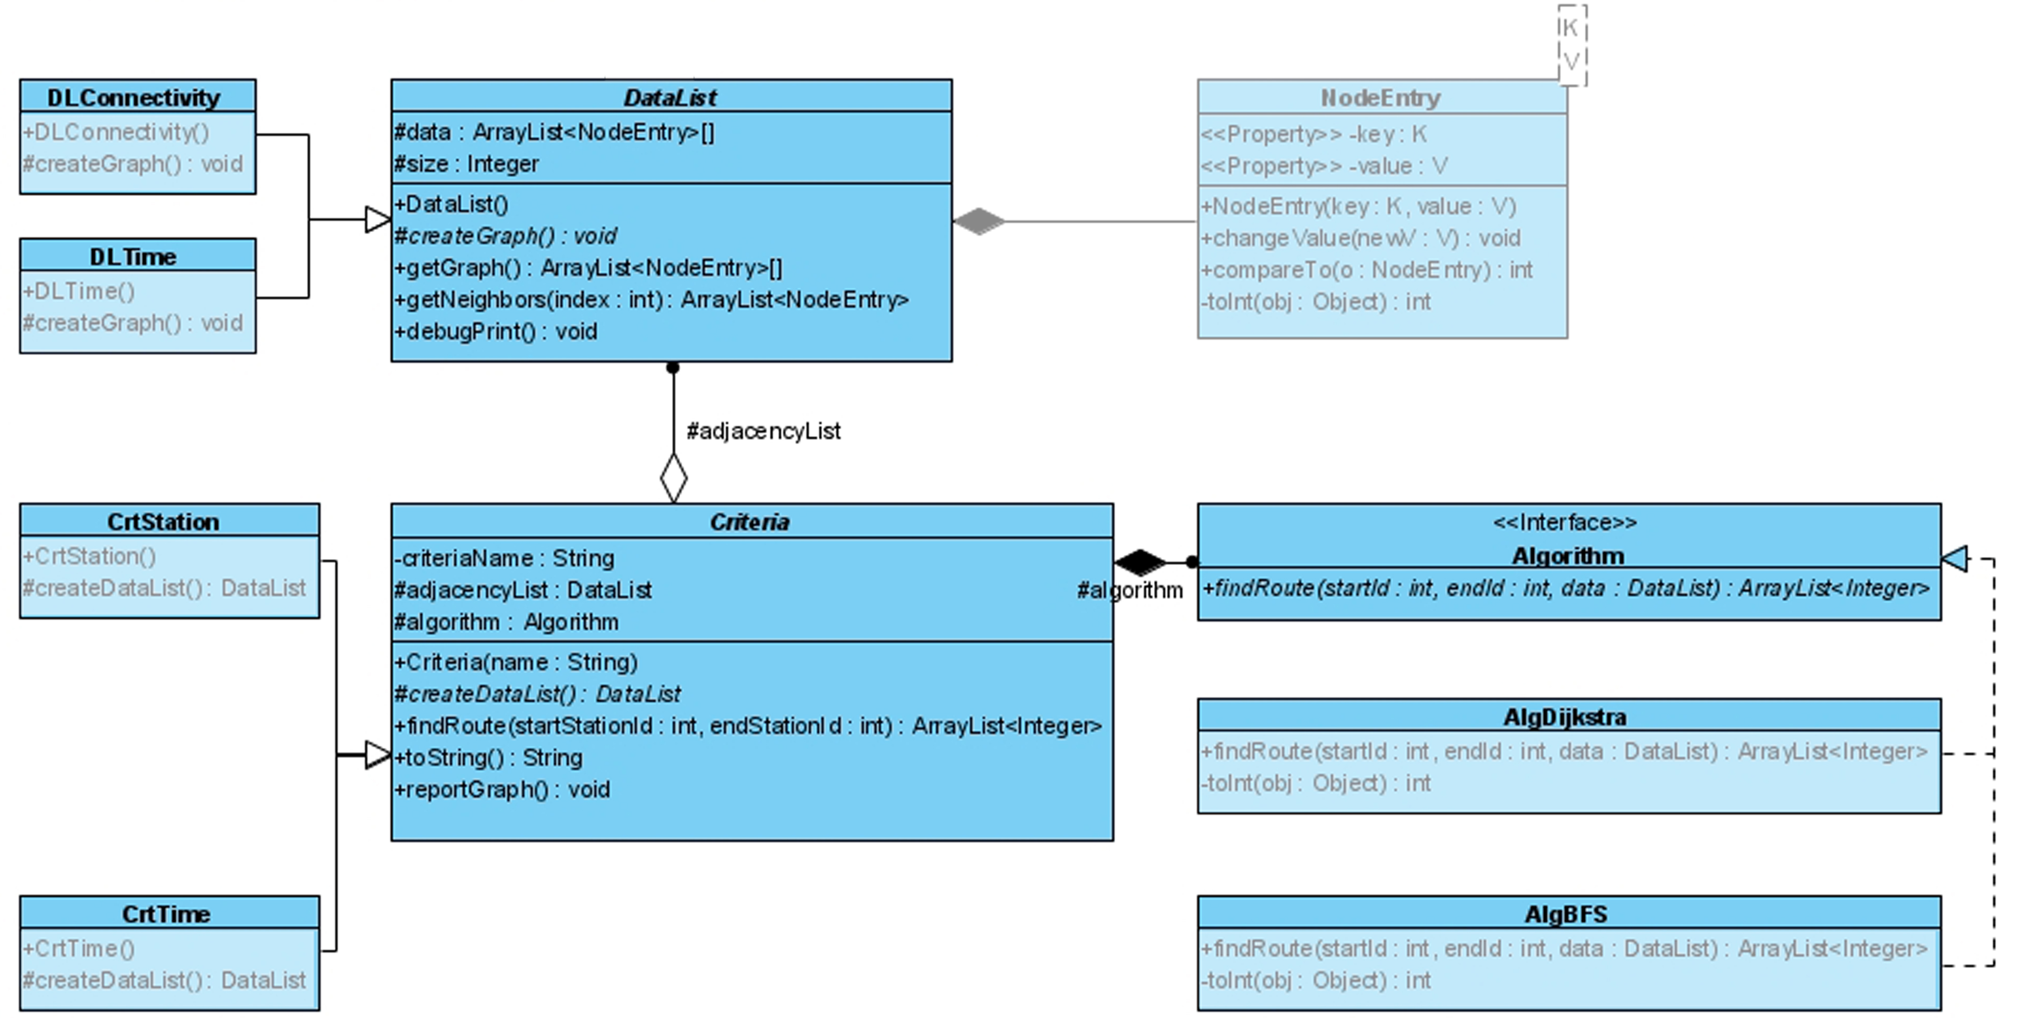
Design
Principle
OCP
LSP
DIP
LoD

Slide 20
Design
Principle
MetroSystem.getDatabase().getStationByName() → MetroSystem.getStationByName()

Slide 21
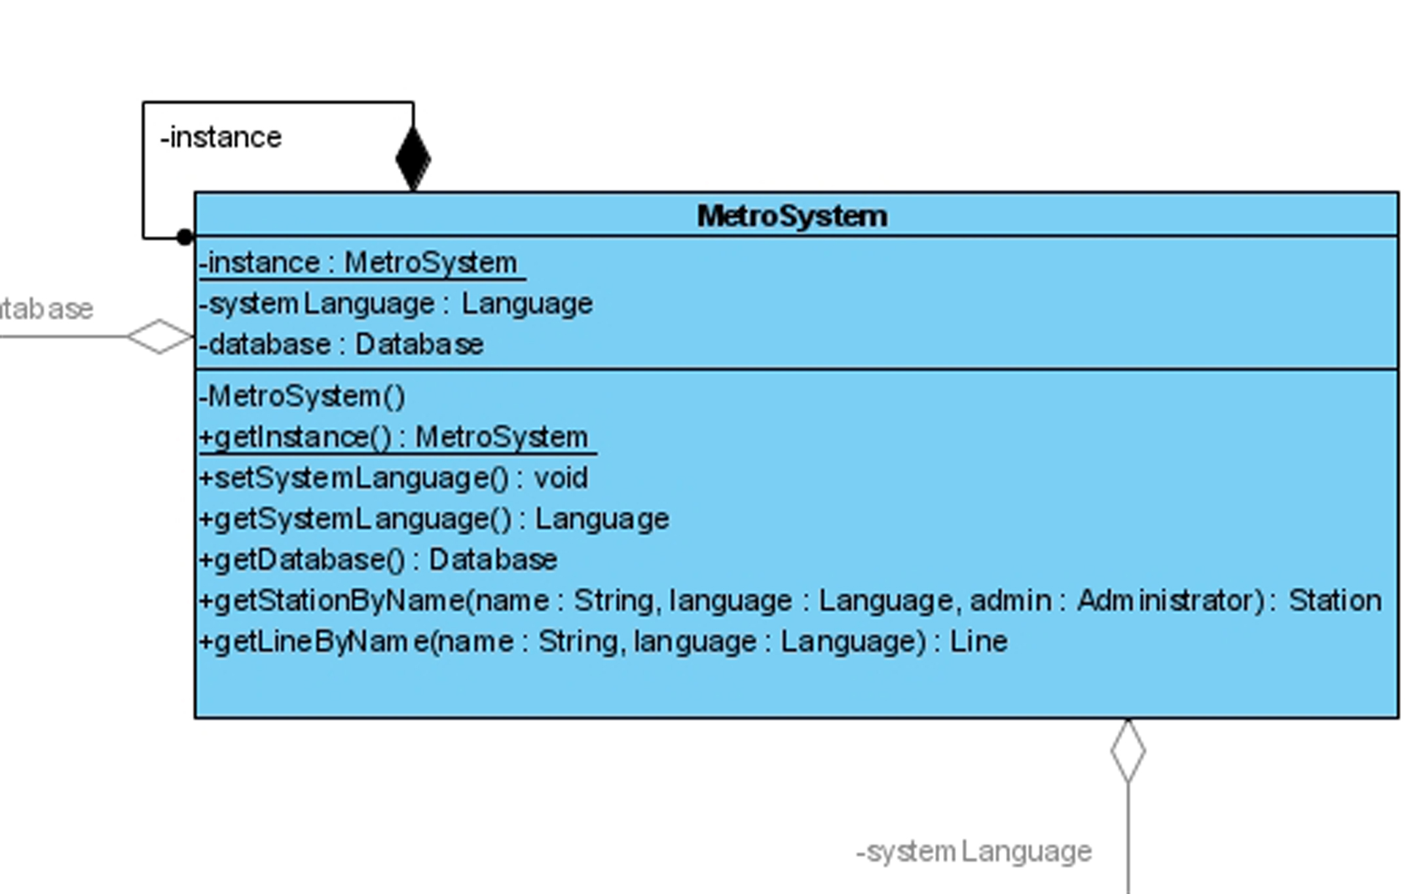
Design
Pattern
Singleton
Strategy

Slide 22
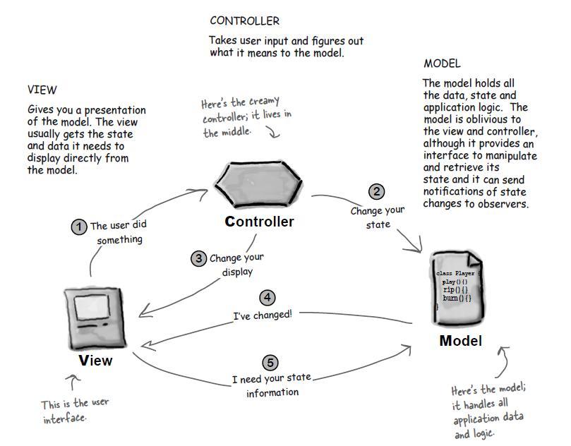
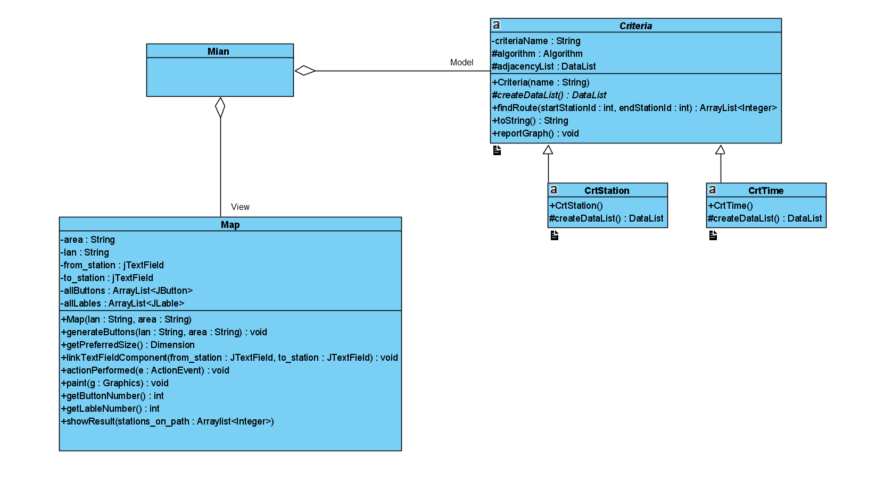
Design
Pattern
Model-View-Controller Pattern

Slide 23
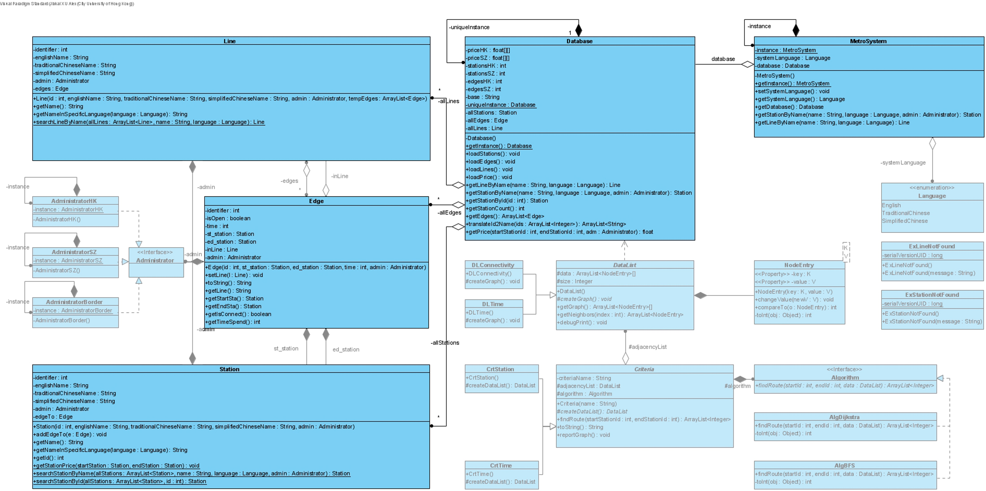
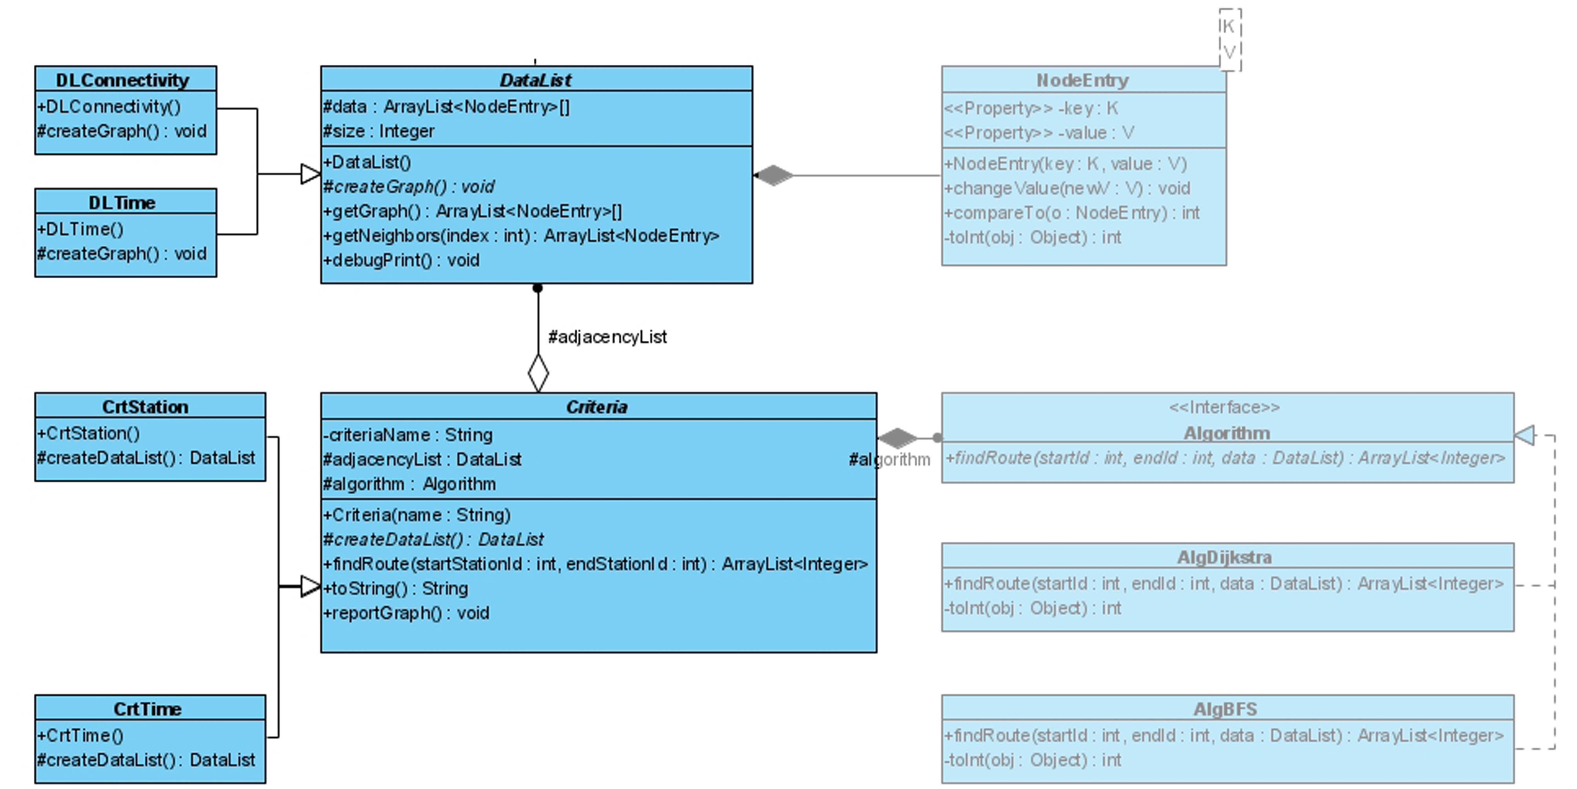
Design
Pattern
Façade
Factory Method

Slide 24
開發
Development

Slide 25
Development
Program Flow
Back-end data load
Front-end data input
Back-end algorithm implementation
Front-end result display

Slide 26
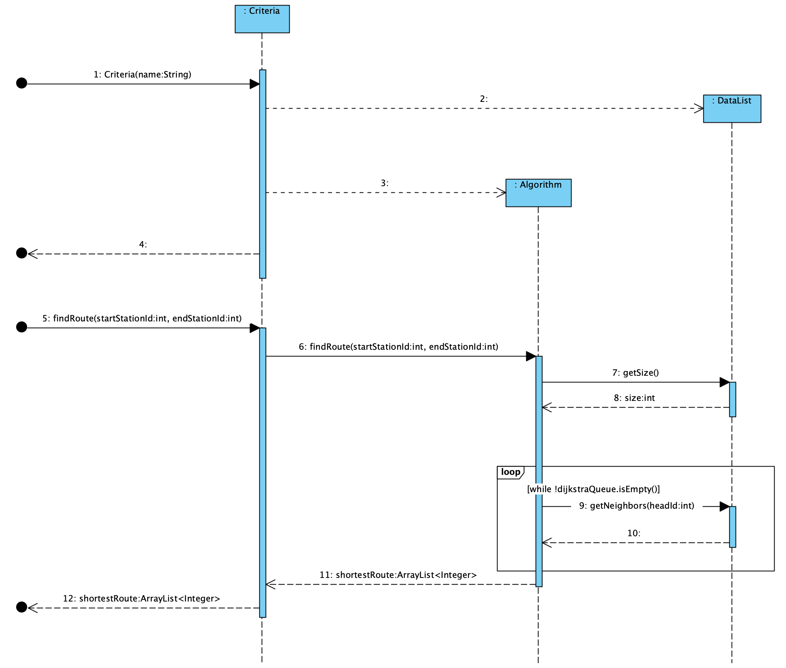
Development
Sequence Diagram

Slide 27
認證
Verification

Slide 28
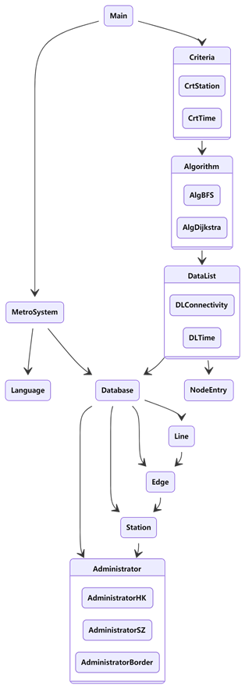
Verification
Integration Testing
System Testing
Unit Testing
Testing
Testing method: Bottom-Up

Slide 29
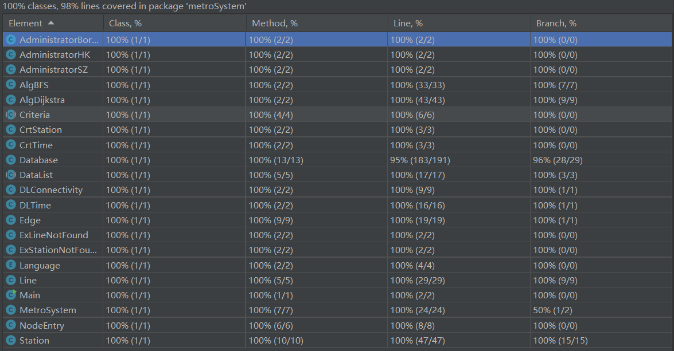
Verification
Coverage
Statement Coverage
Branch Coverage
Condition Coverage
Decision Coverage

Slide 30
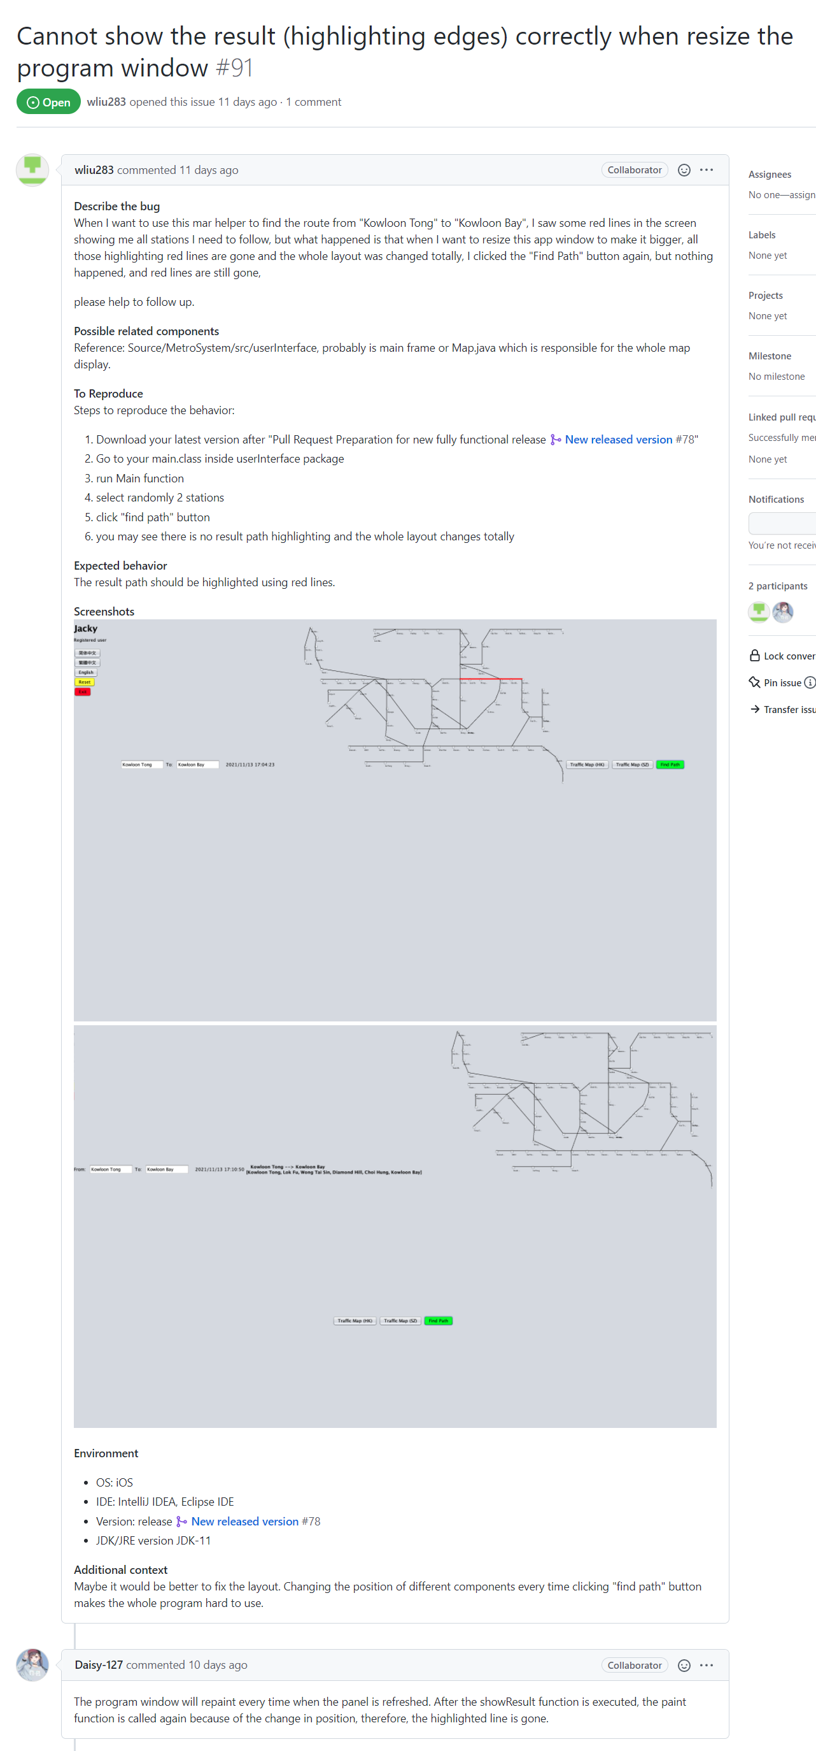
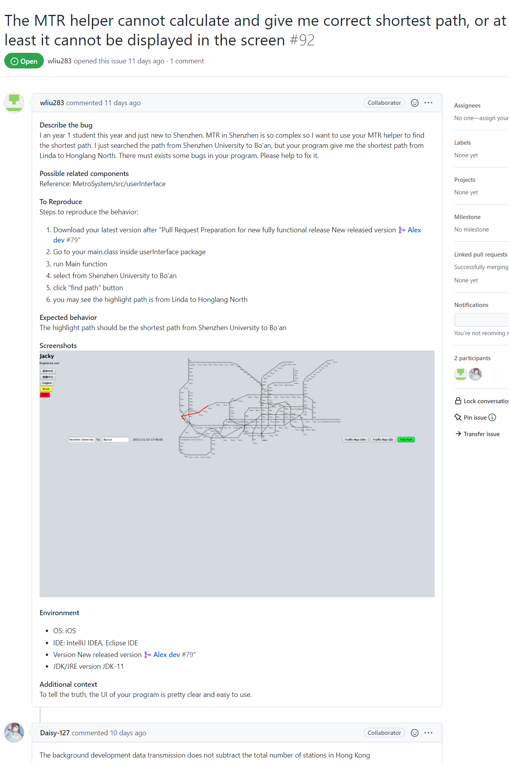
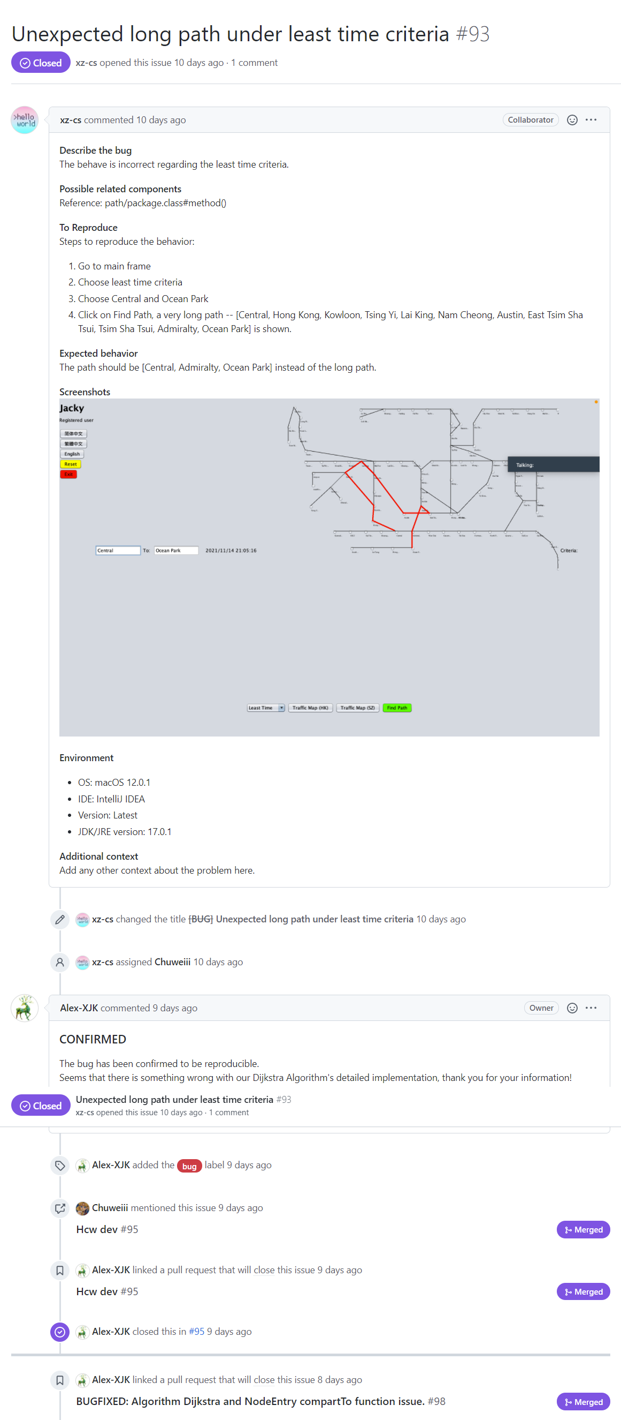
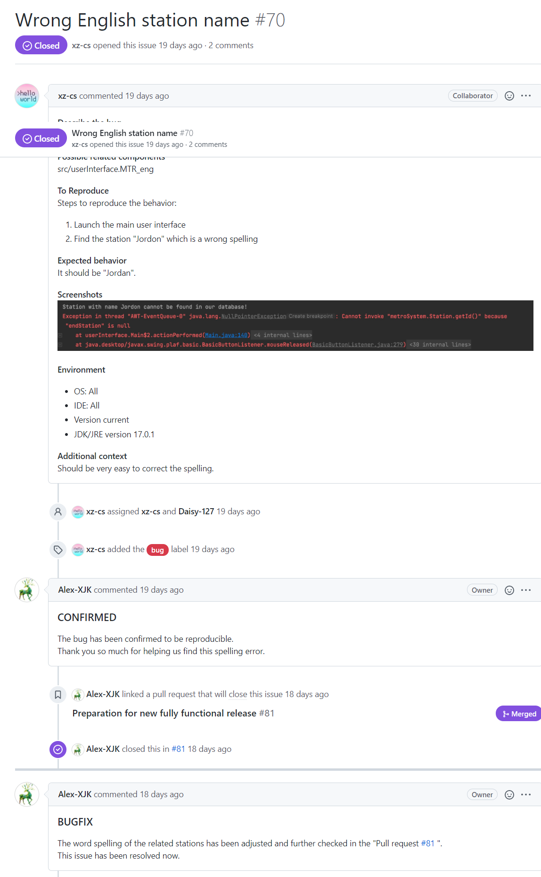
Verification
Bug Report

Slide 31
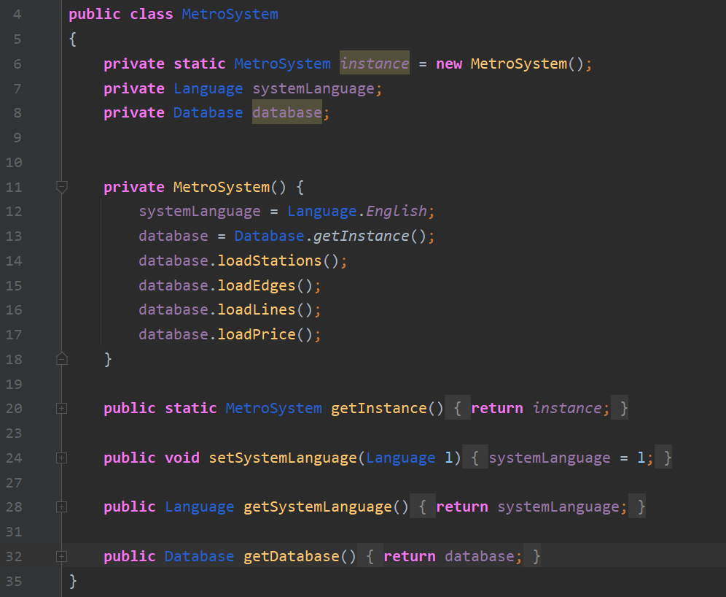
Verification
Refactoring
EXAMPLE 1
m.getDatabase().getStation()
->
m.getStation()
Follow the LoD principle!

Slide 32
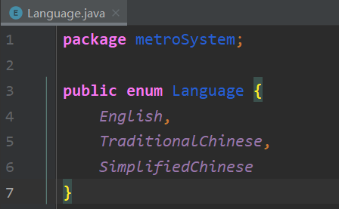
Verification
Refactoring
EXAMPLE 2
TraditionalChinese.getInstance()
->
Language.TraditionalChinese
Singleton class to enumerate class;
Avoid instanceof

Slide 33
用戶介面
User Interface

Slide 34
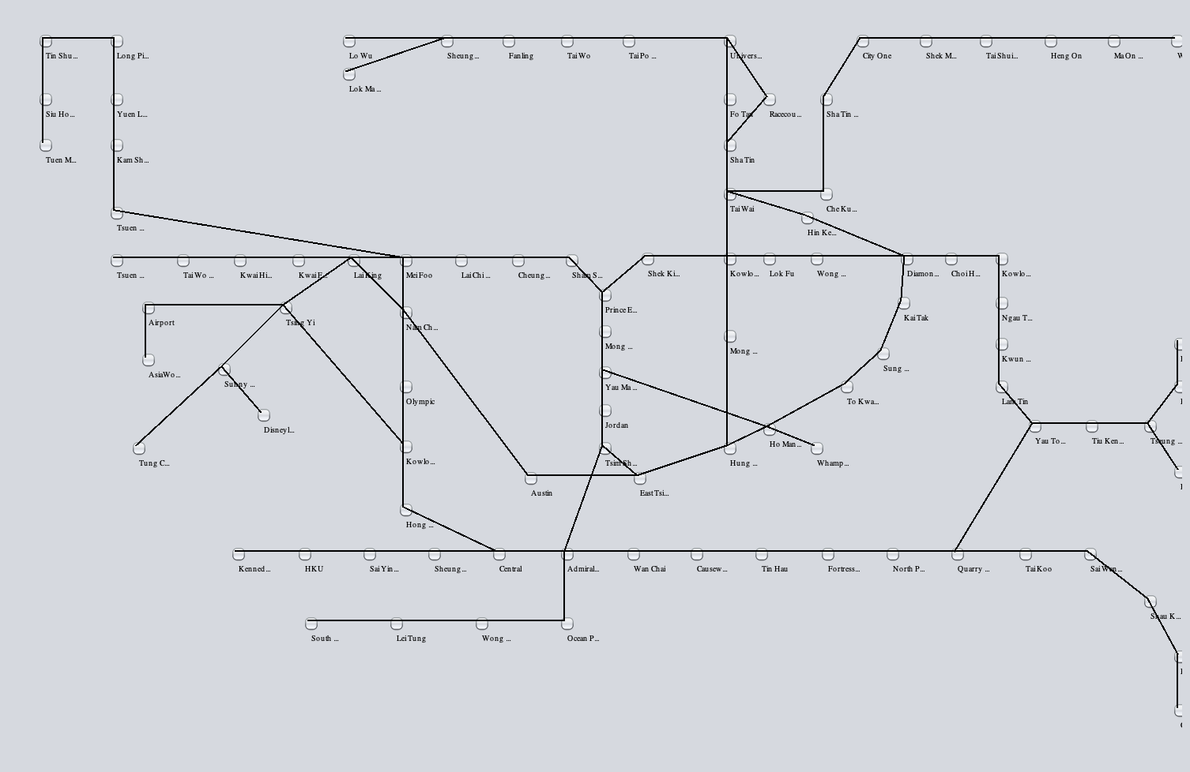
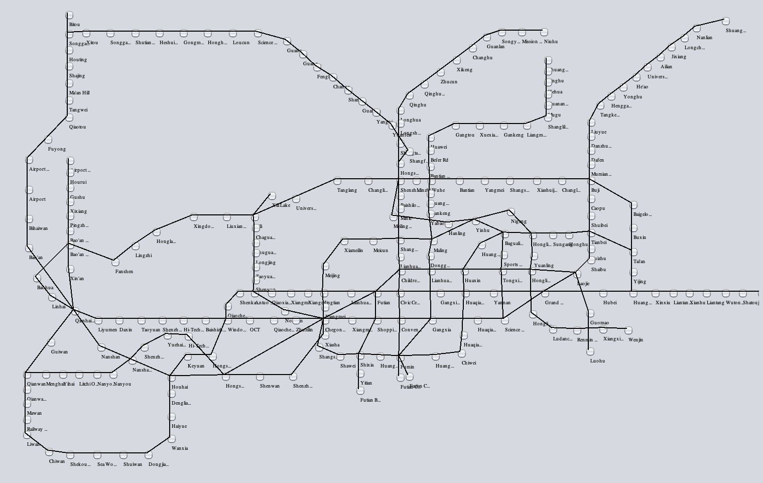

User Interface
Two maps
Internal Map Panel
Hong Kong
Shenzhen

Slide 35




User Interface
Internal Map Panel
Precise station location
User-friendly interface

Slide 36
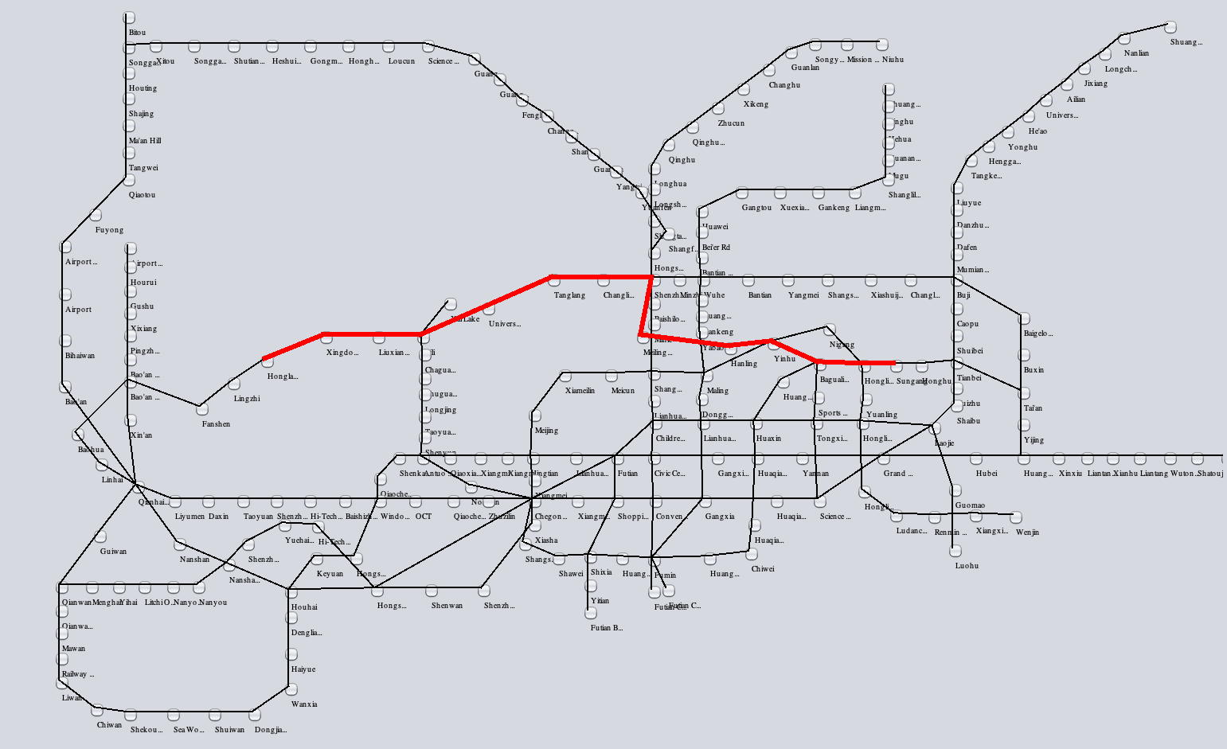

User Interface
Internal Map Panel
Interactive design
Path highlighting

Slide 37
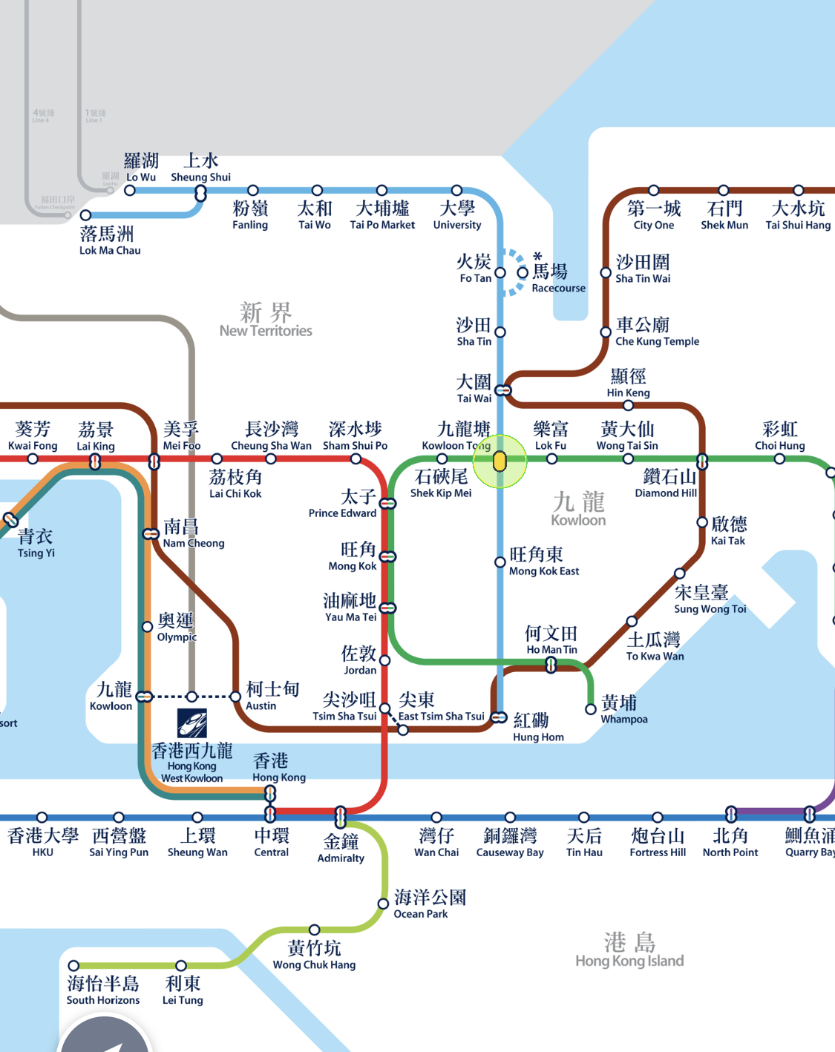
Prototype
Old design
From:
To:
Weather: Sunny 20‘C
Kowloon Tong
Causeway Bay
1st Oct. National Day
Jacky
Registered user
Nearest station
Map
Today
Checkpoint
History
Settings
Log out
Traffic News (HK)
Clear
Traffic News (SZ)

Slide 38
Prototype
New design
From:
Kowloon Tong
To:
Causeway Bay
2021/11/11 20:31:39
Jacky
Registered user
简体中文
繁體中文
English
Reset
Exit
Traffic Map (HK)
Find Path
Criteria:
Least Time
Traffic News (SZ)

Slide 39
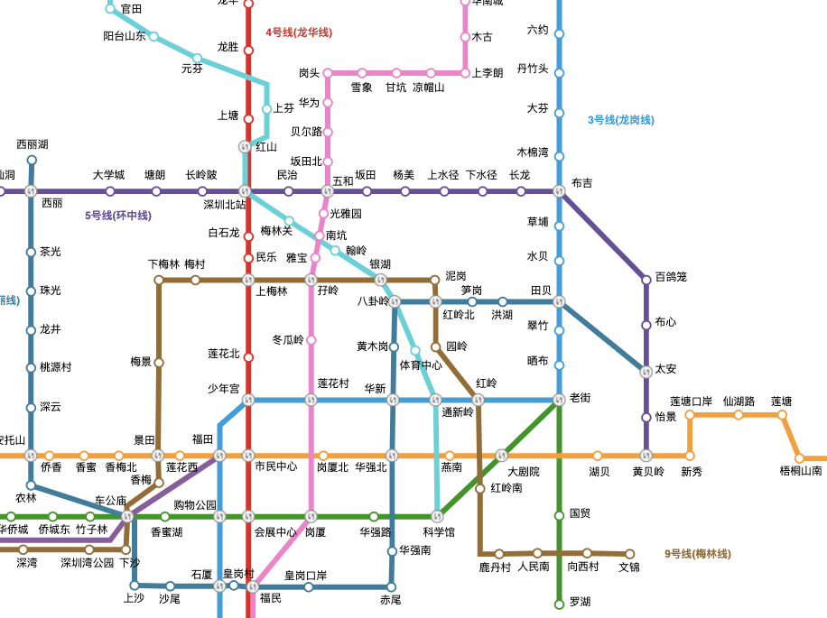
Prototype
New design
From:
Kowloon Tong
To:
Causeway Bay
2021/11/11 20:31:39
Jacky
Registered user
简体中文
繁體中文
English
Reset
Exit
Traffic Map (HK)
Find Path
Criteria:
Least Station
Traffic News (SZ)

Slide 40
Thank You ! ! !

